Slide 1
Virginia Tech
Information Technology
Project Management
Departmental Computer Support Symposium
Tuesday, April 4, 2017
Greg Kroll

Slide 2
Why do we have a standard for information technology project management?
Higher Education Restructuring (Restructured Higher Education Financial and Administrative Operations Act)
http://www.schev.edu/index/institutional/planning-and-performance/restructuring
Management Agreements – Policy Governing Information Technology
http://leg1.state.va.us/cgi-bin/legp504.exe?061+ful+CHAP0933
Standard for information technology project management
http://www.pm.it.vt.edu

Slide 3
What projects must follow this standard?
ALL information technology projects at Virginia Tech

Slide 4
^{What projects are excepted?}
Research projects e.g., Autonomous Robotics
Research Initiatives e.g., Bring Your Own Everything (BYOE)
Instruction e.g., Virginia Cyber Range
Maintenance and operational activities e.g., upgrade OS on server farm

Slide 5
Currently Reviewing and Updating the ^{standard}
Recent Internal Audit provided recommendations for improvement
Review and update to Policy 7210 ^{(IT Project Management)}
Review and update to the standard for information technology project management (www.pm.it.vt.edu)

Slide 6
^{Important Revisions}
^{Minor updates to Policy 7210} ^{(IT Project Management)}
Policy & Standard enhanced to improve suitability for other forms of project management besides waterfall methodology
Completely redesigned decision support tool – the project ScoreCard – new categories of risk & complexity, easier to understand

Slide 7
^{Risk Analysis}

Slide 8
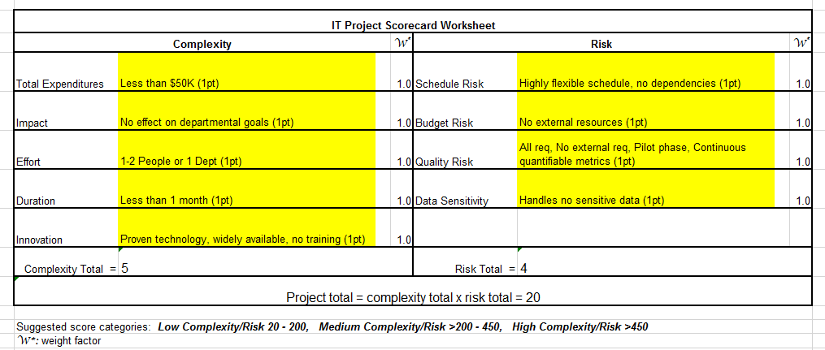
^{IT Project ScoreCard}

Slide 9
^{Who makes the decisions?}
New concept of a “Decision authority” Usually the person with budget authority to commit resources to the project, often a department head (as defined in Policy 6100 but also includes the administrative head of institutes, centers, and administrative departments)
Where a project requires access to or integration with enterprise data or systems (Division of IT), the expectation is to incorporate the level of project management recommended by this standard
The Vice President for Information Technology/Chief Information Officer (VPIT/CIO) is the decision authority for consideration of justified exceptions

Slide 10
^{What costs are included?}
Procurements e.g., hardware, software, maintenance contracts, etc. (unless procurement is handled separate from implementation)
Network related e.g., network connection fee, load balance, storage, etc.
Personnel costs e.g., project team, new FTE, etc.
Advertising and Marketing e.g., other than VT News, posters, commercial advertising, etc.
Leasing & Rentals e.g., Office space, equipment, etc.

Slide 11
Special consideration for major IT projects
“Major” IT Projects
"Major information technology project" means any Commonwealth information technology project that has a total estimated cost of more than $1 million or that has been designated a major information technology project by the [Commonwealth] CIO pursuant to the Commonwealth Project Management Standard developed under § 2.2-2016.1.”

Slide 12
Expectations for major IT projects
Notify the office of the Vice President for Information Technology that you are initiating a major IT project
Approval from a higher authority (e.g., Provost, Vice President, Dean) on how to proceed with project management of the project
Create and approve a project charter (in place of a project initiation form)
Provide detailed project documentation that is appropriate to the risk and complexity of the project
Plan and budget for independent verification and validation for the project
Submit quarterly project status reports to the office of the Vice President for Information Technology to submit to the Commonwealth of Virginia

Slide 13
Why would I want to do all this?
Reduces risk project reviews allow, continuous risk assessment, monitoring of milestone targets
Controls Costs monitoring budget controls project cost overruns, allows for better resource allocations
Supports Organizational Goals allows measuring quantitative and qualitative project outcomes more frequently, improves strategic alignment with business needs & goals
Improved Success Rate projects completed on-time and on-budget

Slide 14
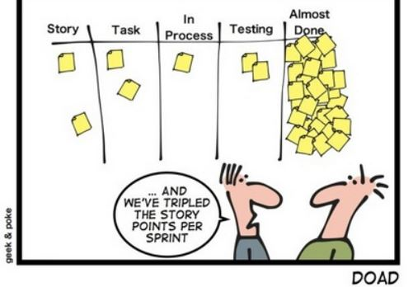
^{Agile Methodology}

Slide 15
^{Questions?}
^{Contact info:}
^{Greg Kroll}
^{gkroll@vt.edu}
²³¹⁻⁹⁶⁵⁴
^{http://www.pm.it.vt.edu/}

