Slide 1
InnovationSpace 2.0
Quinn Warnick
Senior Director of Academic Innovation and UX
TLOS

Slide 2


Slide 3
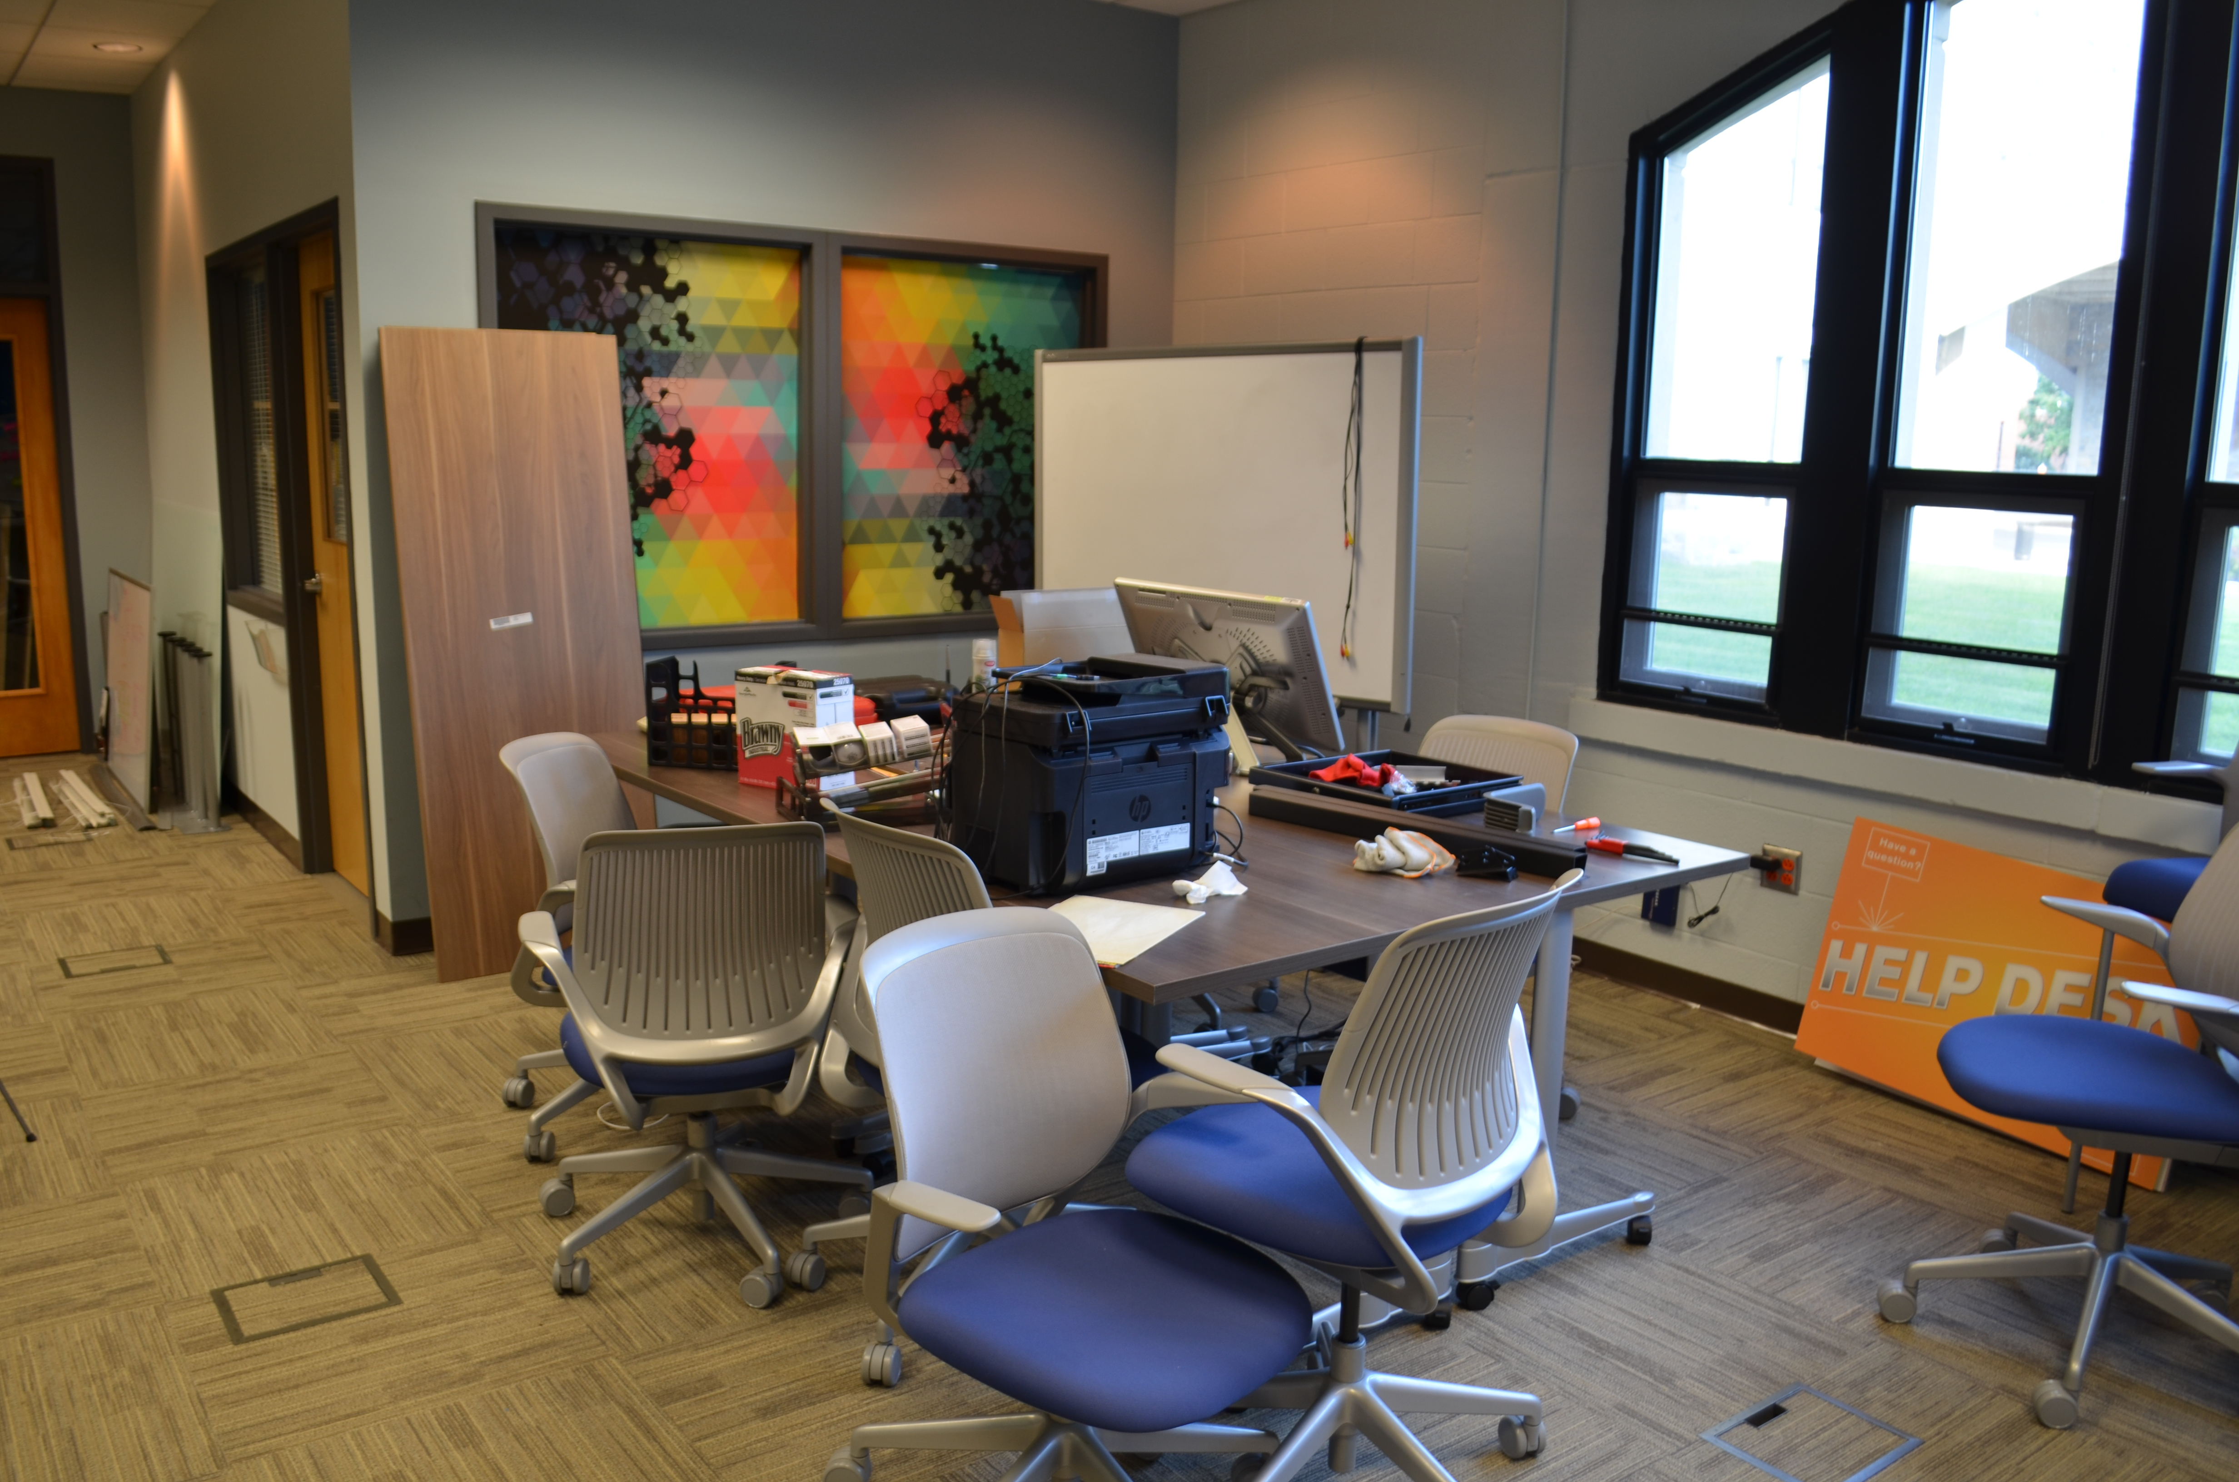

Slide 4
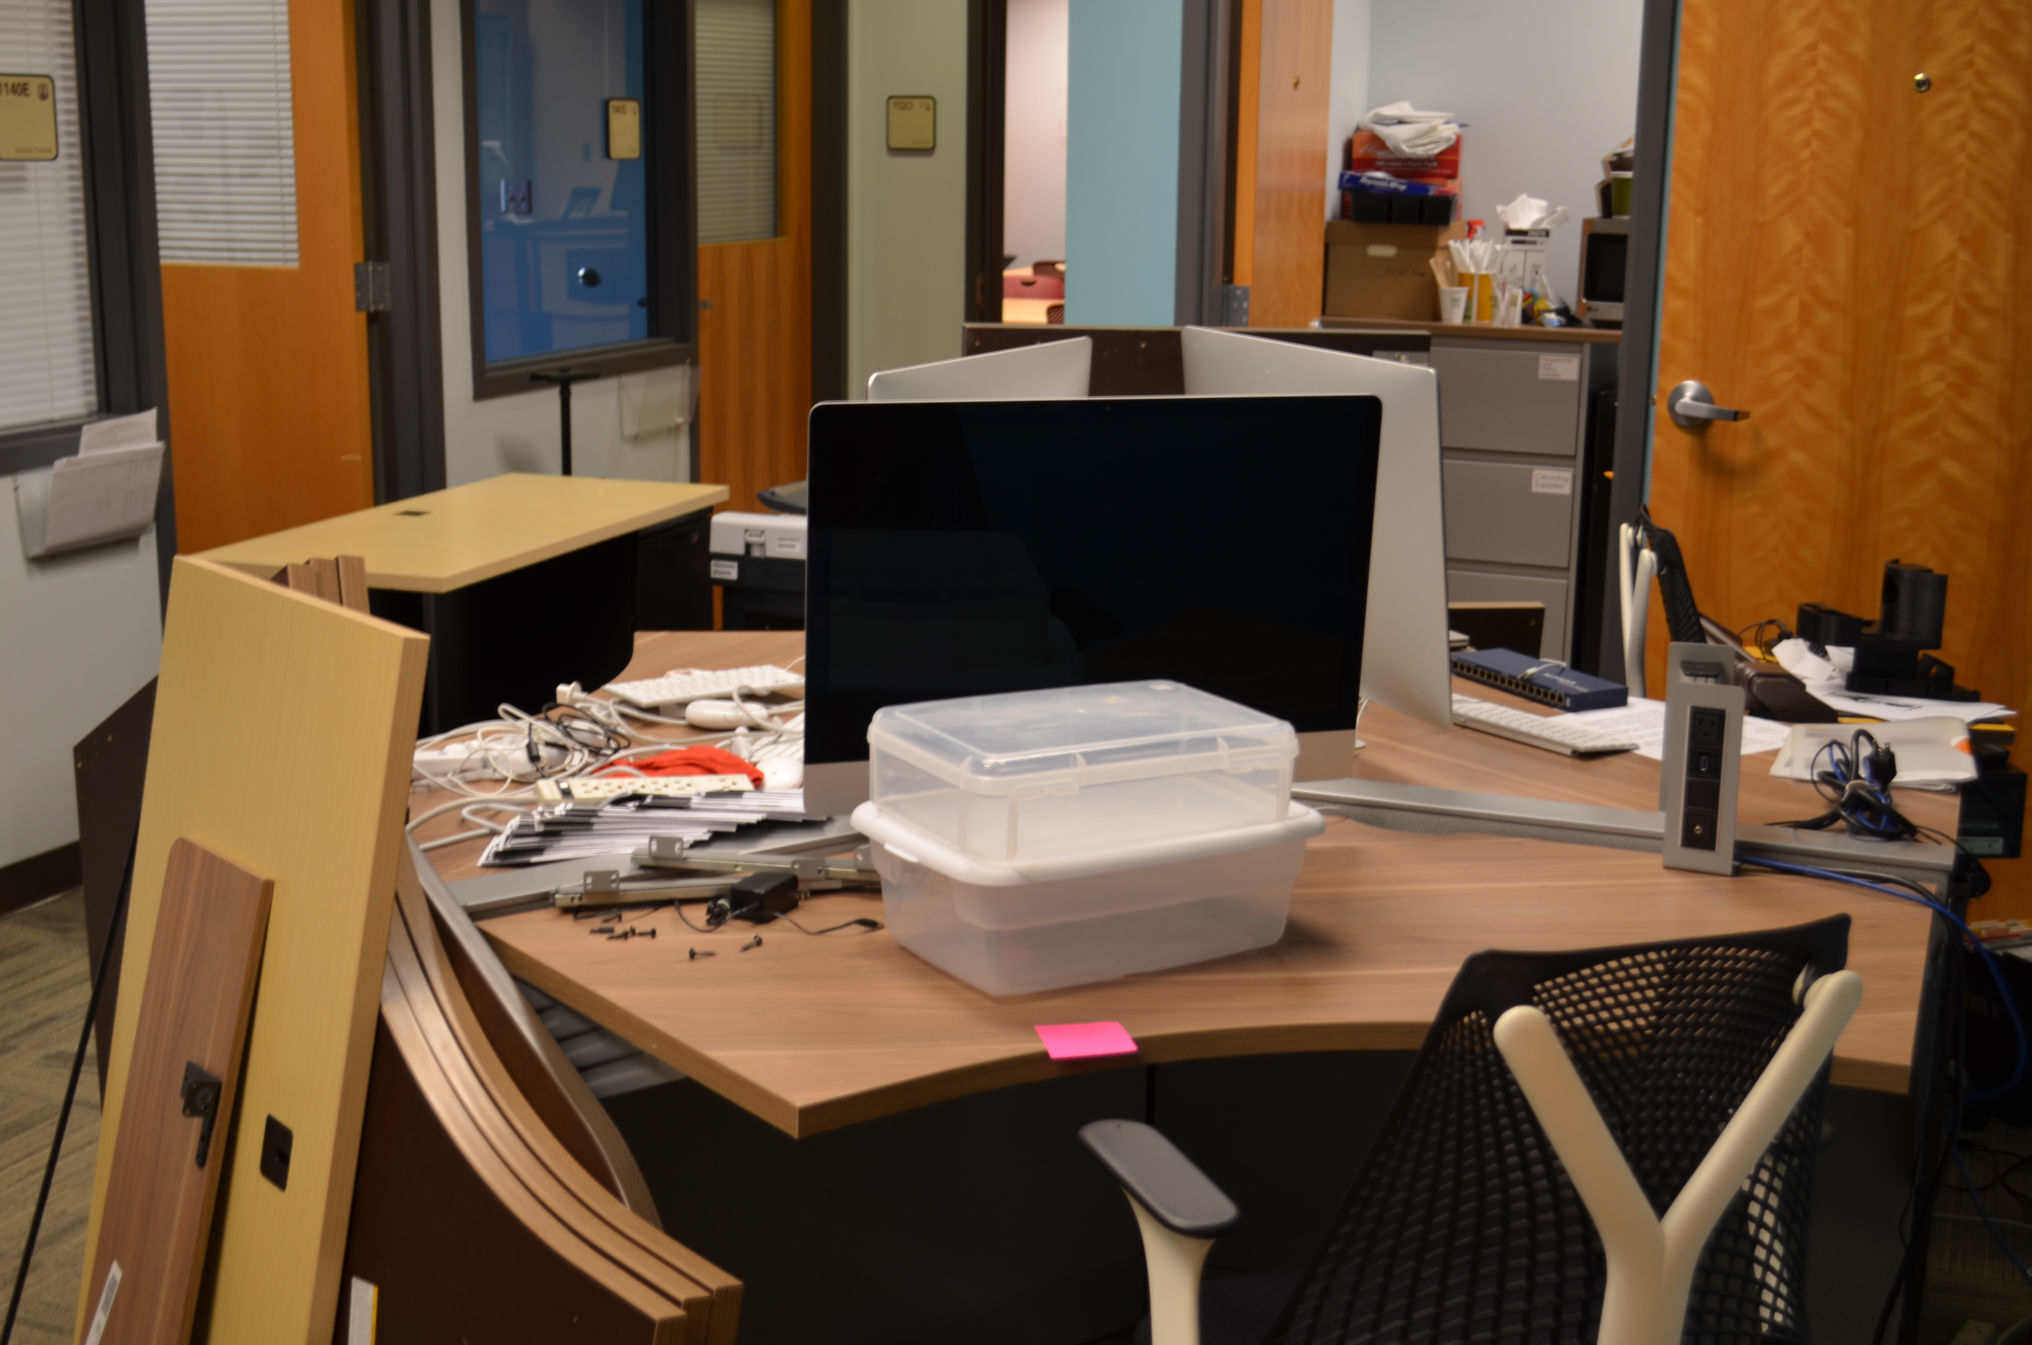

Slide 5
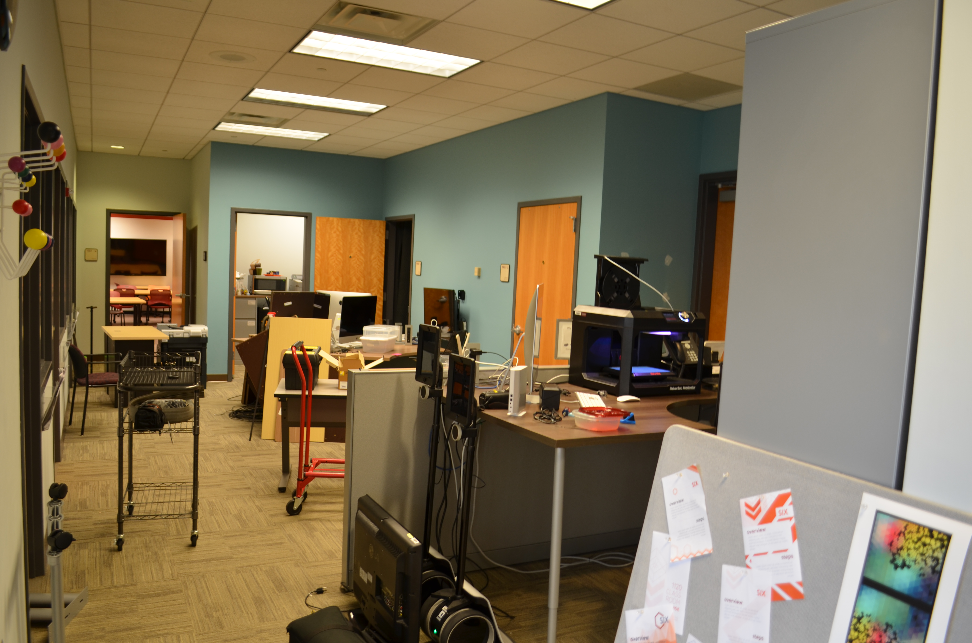

Slide 6
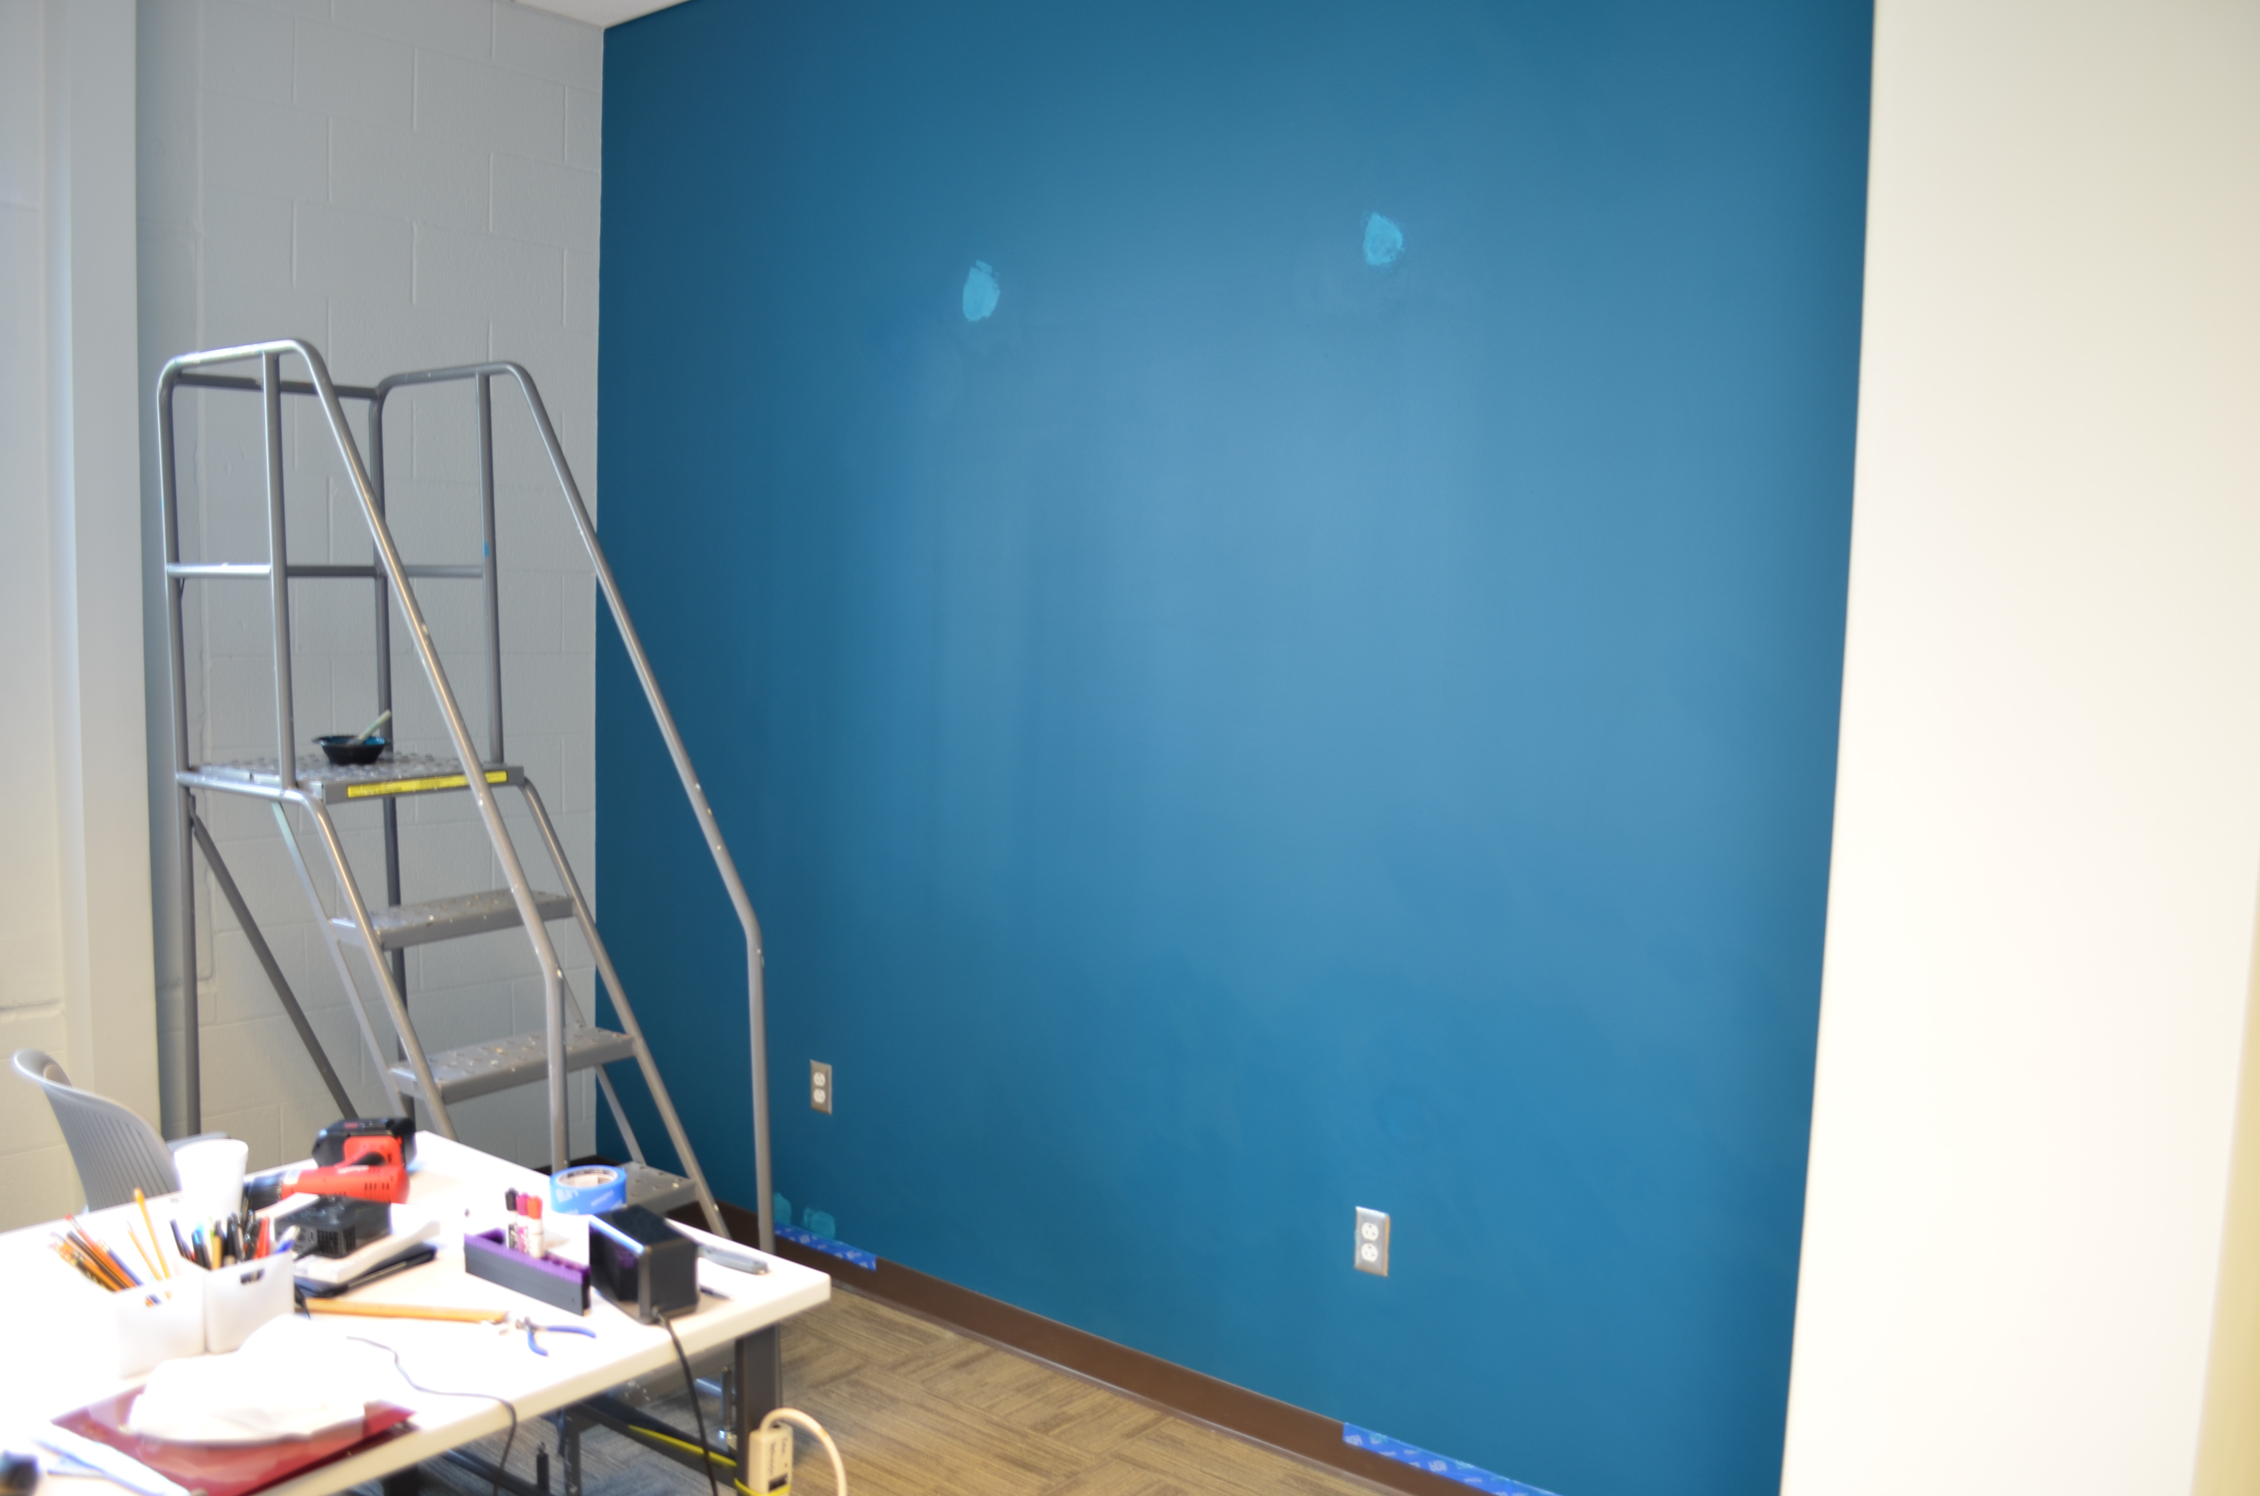

Slide 7
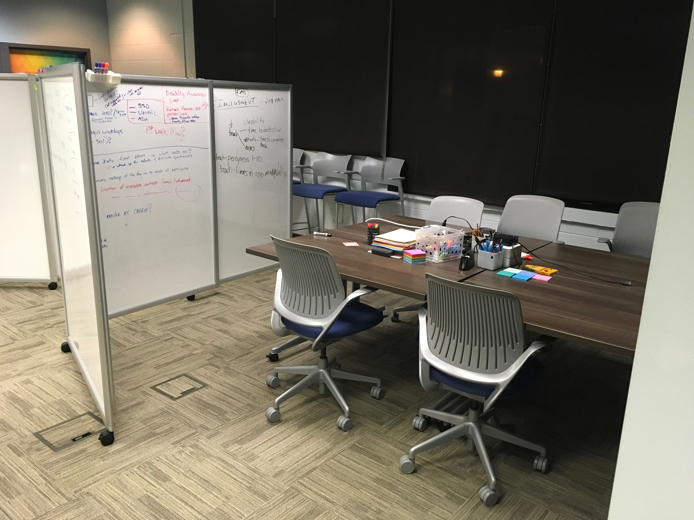

Slide 8
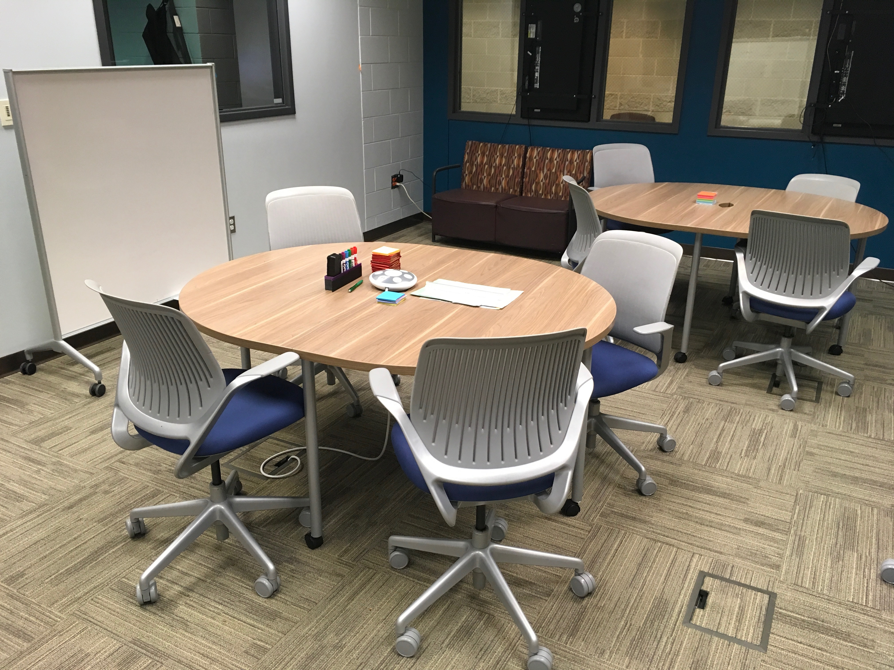

Slide 9
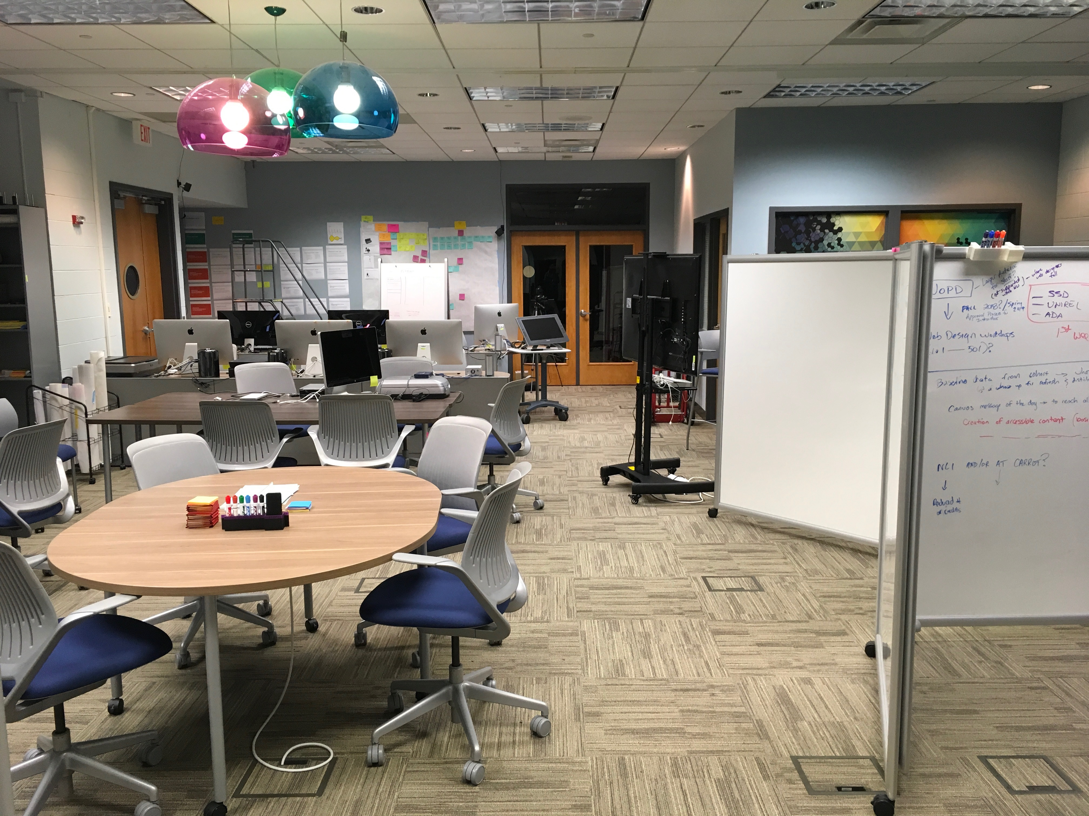

Slide 10
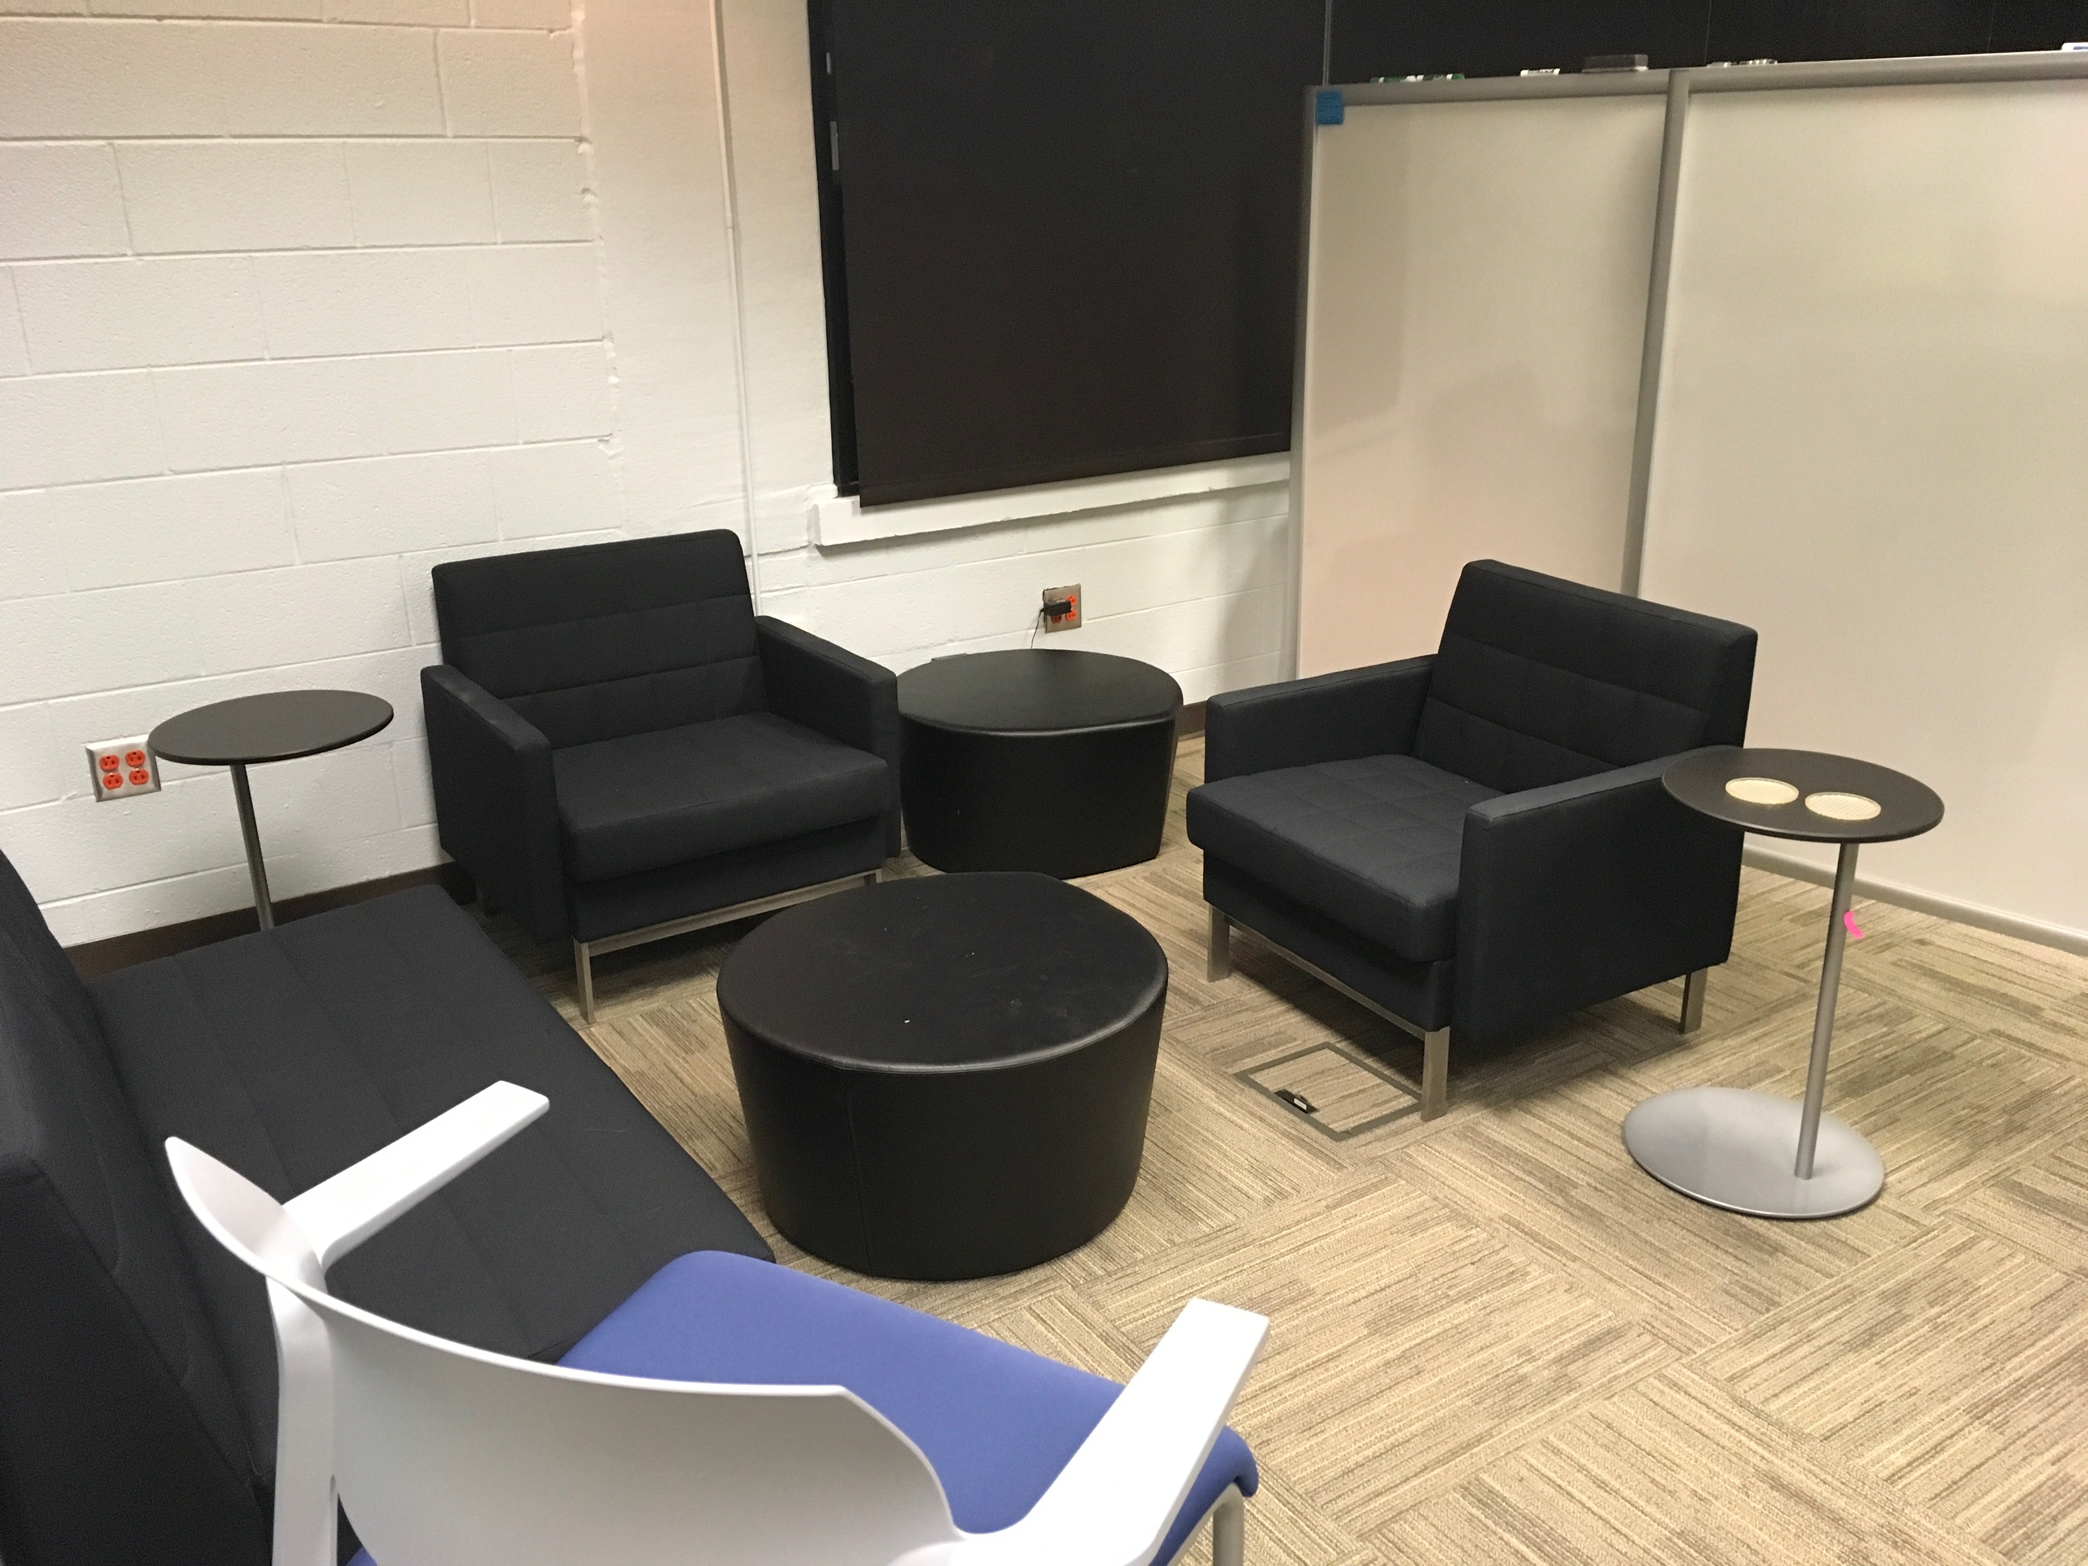

Slide 11
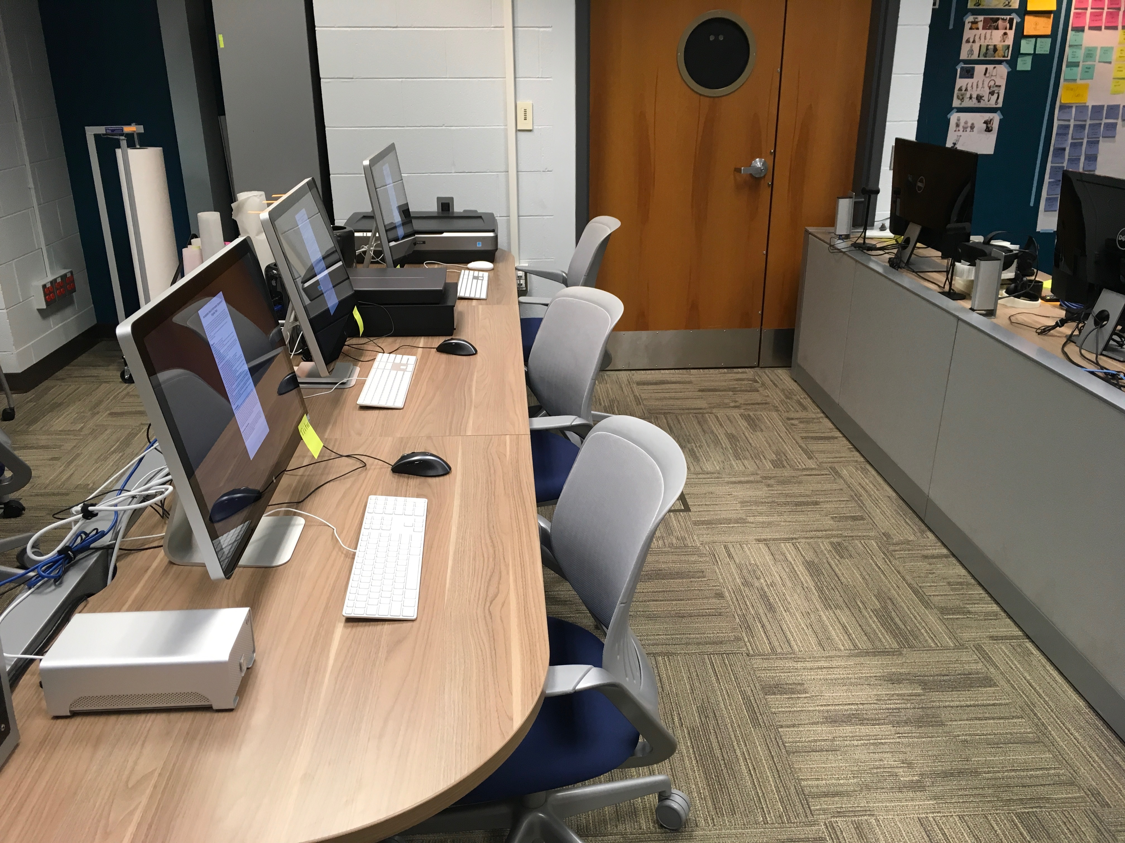

Slide 12
Innovation in Learning Grants
Support the implementation and evaluation of new approaches to teaching and learning with technology.
Designed to seed larger grant applications and/or lead to presentations and publications.
Funds can be used for hardware, software, or faculty/student time.
Targeted at collaborative projects with the potential for broad impact and wider implementation.
Typically range from $5,000 to $15,000.

Slide 13
Sandbox Projects
Explorations of new tools, ideas, and approaches in technology-enhanced learning
Three key criteria for consideration:
Collaborative
Time-limited
Hypothesis-driven
Open call for proposals, reviewed on a rolling basis.
Typically range from $1,000 to $5,000.

Slide 14
XCaliber Awards
Celebrates courses and significant projects that demonstrate exemplary use of technology and student-centered pedagogy resulting in high-impact student learning.
Individual faculty and larger project teams can be nominated.
Winners (typically two per year) receive an honorarium and recognition at the university’s faculty/staff awards dinner.
Short-form nominations due in early December; finalists submit a full application packet in early February.

Slide 15
Other Services and Opportunities
Ongoing checkout of multimedia equipment to faculty
Faculty access to specialized hardware and software (video and audio editing, 3-D printing, scanning, virtual reality, 360-degree video, etc.)
Design-thinking facilitation and problem solving
User-experience research (usability testing, prototyping, focus groups, etc.)
Matchmaking conversations for anything related to technology-enhanced learning

Slide 16
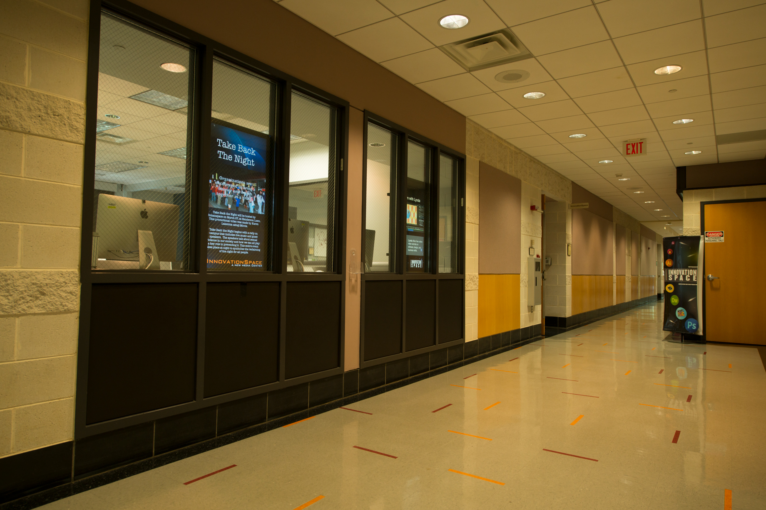
Visit us in 1140 Torgersen Hall
or contact us online:
is.vt.edu
innovationspace@vt.edu

