Slide 1
Cloud-based Resources for Cybersecurity Education and Training
David Raymond, Ph.D.
Director, Virginia Cyber Range
draymond@virginiacyberrange.org

Slide 2
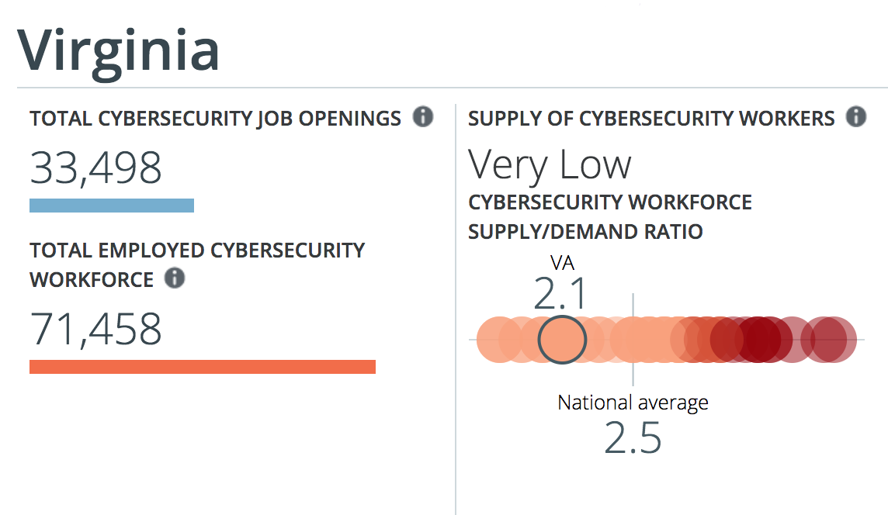
Cybersecurity Talent Shortfalls

Slide 3
What is a Cyber Range?
Isolated network
Activity will appear malicious
Actual malware sometimes used
Usually virtualized
Allows for maximum configurability
Scripted network environment creation
Used for:
Hands-on cybersecurity training
Defensive AND offensive
Classroom exercises
Capture-the-flag and red/blue CTFs
Device and software testing
Incident response rehearsals

Slide 4
Virginia Cyber Range: Background
Recommended by the Virginia Cyber Security Commission in August 2015
Funded by Commonwealth of Virginia on July 1st, 2016
2016 Executive Budget Document, Item 224, Paragraph J:
“Out of this appropriation, [two years of funding will be] designated to support a cyber range platform to be used for cyber security training by students in Virginia's public high schools, community colleges, and four-year institutions. Virginia Tech shall form a consortium among participating institutions, and shall serve as the coordinating entity for use of the platform. The consortium should initially include all Virginia public institutions with a certification of academic excellence from the federal government.”
Notes:
4 States have more CAEs than Virginia (10) – we want to be at the top!
Florida: 14
Maryland: 17
New York: 12
Texas: 16

Slide 5
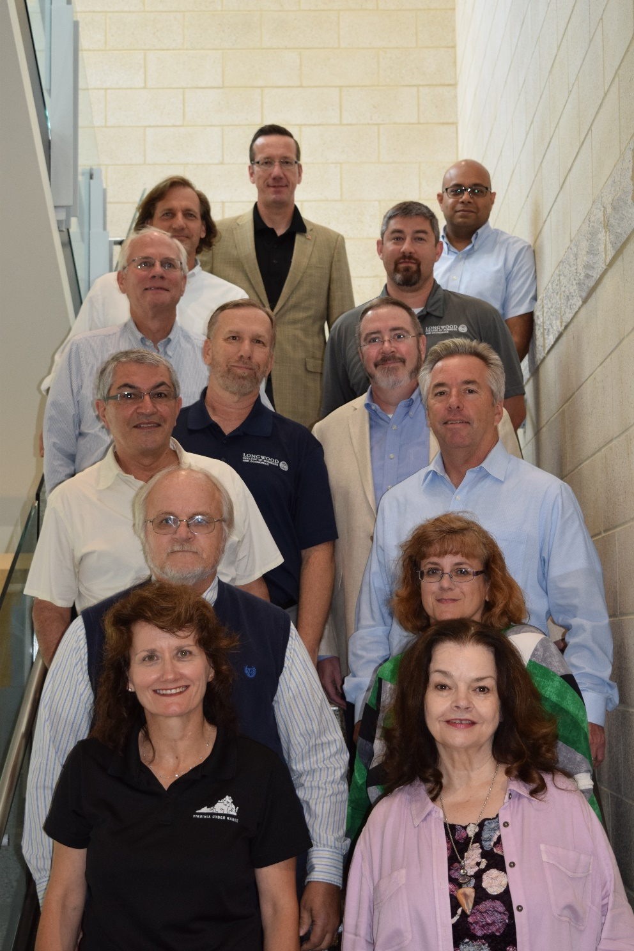
Governance: Executive Committee
George Mason University James Madison University Longwood University Lord Fairfax Community College Norfolk State University Thomas Nelson Community College Northern Virginia Community College Radford University Tidewater Community College Virginia Tech Danville Community College University of Virginia

Slide 6
Courseware Repository
Exercise Area
Community of Purpose
Courses, modules, and exercises for use in HS, CC, and university cybersecurity curricula
Instructors/professors can select course content in full or a la carte
Grants offered for courseware development
Menu of per-student exercise environments for use in cybersecurity courses
Working towards team-based offensive and defensive, scenario-based environments
Capture-the-Flag infrastructure for cybersecurity competitions
Consortium governance
Convene workshops and conferences to “teach the teachers” and share best practices
Helping to expand NSA/DHS CAE certification among Virginia colleges and universities

Slide 7
Leveraging the Public Cloud
Design Requirements:
Difficult to predict resource requirements
Completely automatable
Cost effective
Short-term surge capacity
Available anywhere
Web portal for access to content
Role-based access
Login to see user-specific content
Students just need a web browser and internet connection!
Why the Cloud?
Unlimited scalability!
Quick start-up phase
Low capital investment
Rapid scalability
Surge capacity
Location independent
Highly automated
Pay as you use

Slide 8
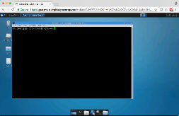
Virginia Cyber Range
Internet
TCP:80;443
Proxy
TCP:80;443
www.
something.
com
Internal IP
10.10.x.y
External IP
TCP:3389
TCP:22
TCP:443
Student
School network

Slide 9
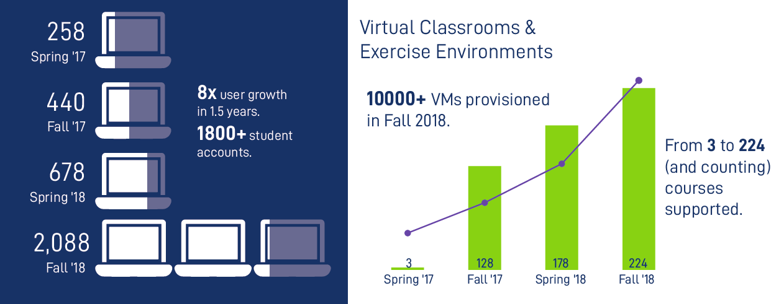
Exercise Area Stats

Slide 10
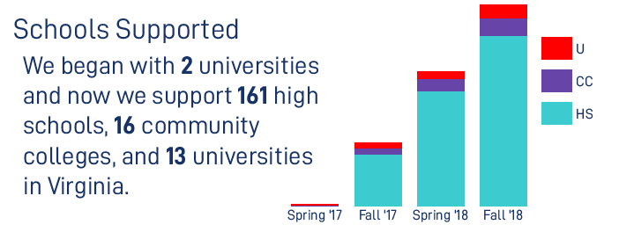
Schools Supported

Slide 11
What is Capture-the-Flag?
Cybersecurity Competition
Can be individual or team-based
Sometimes in-person, often remote
Various formats
Jeopardy-style. Most popular and easiest to create
Attack/Defend (Red/Blue)
Hosted by:
College CTF teams
Companies looking for talent
DoD and other government agencies
You!

Slide 12
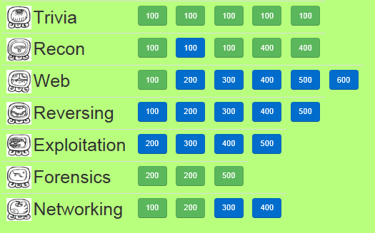
Example Jeopardy Board (NYU-Poly, 2012)

Slide 13
Common Challenge Types: Overview
Reconnaissance (“Recon”)
Answer a question or follow a trail of hints to find a flag
Cryptography (“Crypto”)
Related to simple ciphers or modern cryptography algorithms
Reverse Engineering (“Reversing”)
Analyzing an executable program to produce a flag
Web
Find flag hidden in web page or vulnerable web application
Digital Forensics (“Forensics”)
Find digital artifacts in a drive image
Networking
Find a flag by analyzing captured network traffic

Slide 14
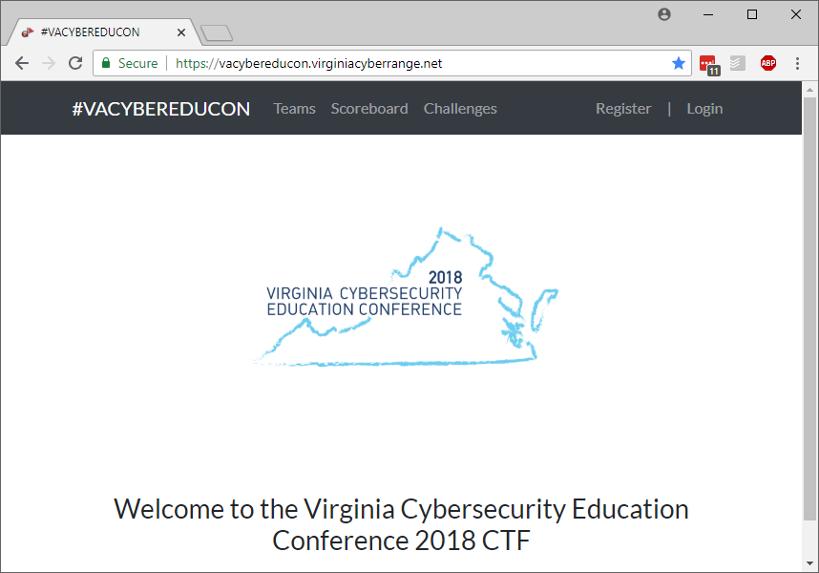
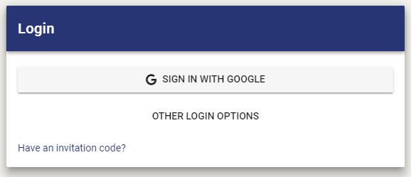
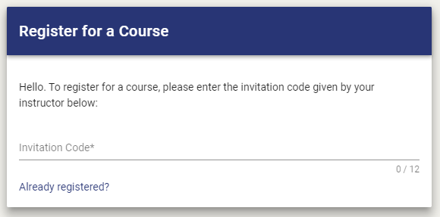
Want to play?
Register for the CTF at https://VACR.IO/CTF2018 (click “Register”)
It might help to have Kali Linux virtual machine for some challenges
https://console.virginiacyberrange.net
On the ‘Login’ dialog, click “Have an invitation code?” and enter 327JPNCKJ2CP
Select login option (Google, Facebook, Azure)
1.
2.
327JPNCKJ2CP

Slide 15
Questions?

