Slide 1
Using ServiceNow to Grow Your
IT Service Management Strategy
Jim Dickhans– Pamplin College of Business
Anne Sheppard – IT Experience and Engagement
Notes:
Good Morning,
I’m Anne Sheppard, with IT Experience and Engagement and this is Jim Dickhans, with the Pamplin College of Business
We wanted to share how using ServiceNow has helped us grow our IT Service Management Strategies
Overview of our transition to using ServiceNow
& Service Partners to date
Quick Update on the Service Catalog
Pamplin CoB’s experience transitioning to ServiceNow and their plans for the future
Updates on licensing costs and upcoming SN training.

Slide 2
Growing our IT Service Management Strategy
4Help transitioned to using ServiceNow for our incident management in Sept 2014.
Provided an environment to develop a comprehensive IT service management strategy
Opportunity to develop more robust partnerships and work more effectively with both enterprise and local IT units.
Notes:
We transitioned to using ServiceNow for incident management in Sept 2014, so we’ve been using it for about 4 years now.
The success of our incident management implementation led to increased interest in other ServiceNow modules which now include:
Requests through the Service Catalog
Project Management
as well as Problem Management which you hear more about in the next presentation.
Using ServiceNow has provided us with an environment to develop a comprehensive IT service management strategy
An essential part of this strategy included a desire to improve our communications with our service partners and to provide a better user experience with our service offerings to our customers.
It also gave us the opportunity to develop more robust partnerships and work more effectively with both enterprise and local IT units.

Slide 3
Our Incident Management Service Partners
College of Agriculture and Life Sciences
Business and Management Systems
Pamplin College of Business
Office of Assessment and Evaluation
University Libraries
VT Carilion School of Medicine
Mining and Materials Engineering
Graduate School
Office of VP for Research and Innovation
Virginia-Maryland College of Veterinary Medicine
Industrial and Systems Engineering
Notes:
Currently we have 11 local IT service partners using incident management which includes many of you attending DCSS today.
Some of our partners are also in the process of developing requestable service catalog entries with workflows to automate their business processes.
To date, 2 of our service partners have their own categories in our IT Service Catalog. However, their categories and the items in them have User Criteria set so they are only available for users with certain department codes.
That way, all users at VT go to one portal, but they can see IT services and department services together.
So far, this has worked well for us

Slide 4
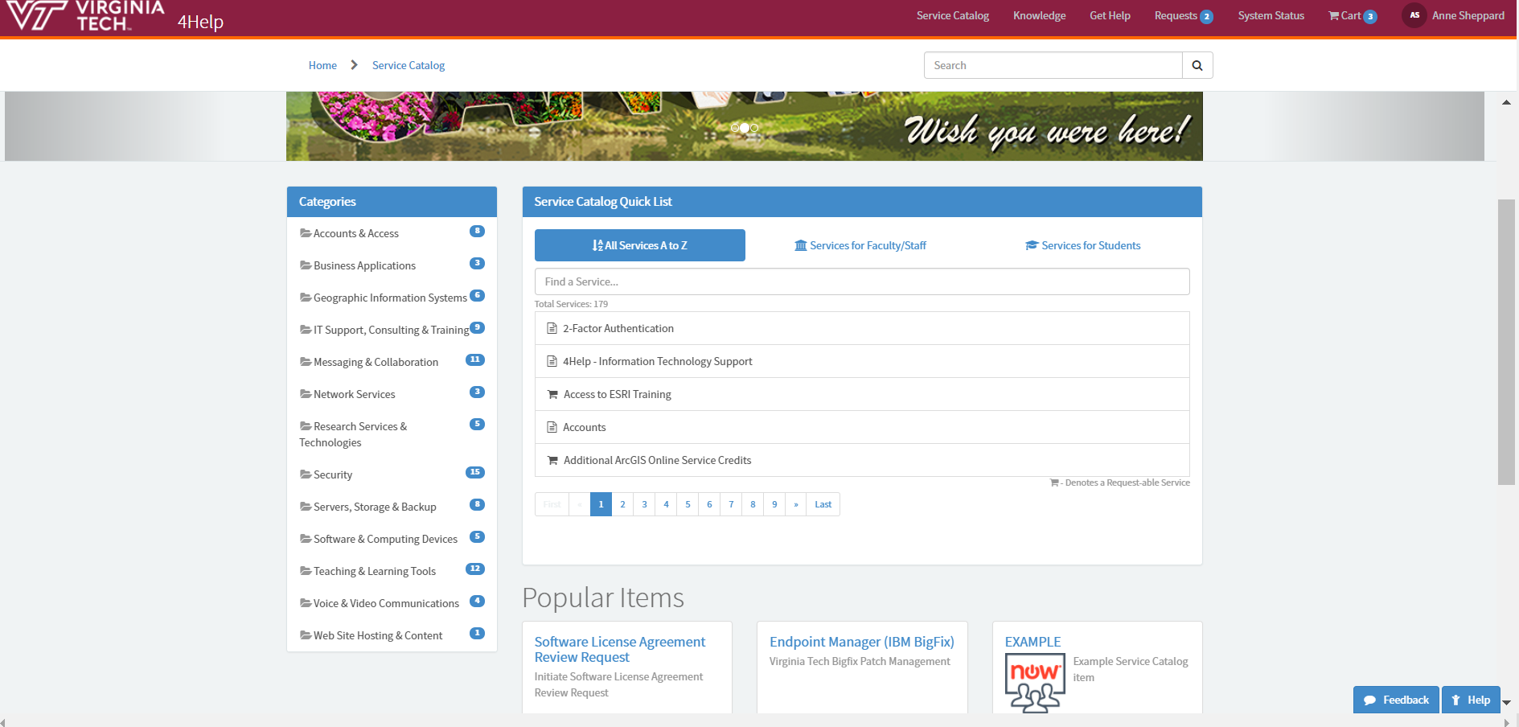
IT Service Catalog
Notes:
Before I turn it over to Jim, I want provide you with a quick update on our Service Catalog.
Together with Service Partners we’ve made a great deal of progress over the past year continuing to grow & evolve the IT Service Catalog
As part of our continuous improvement process, ITEE recently conducted a user experience study to evaluate the information architecture of the catalog.
Based on the results of this study, a plan was developed to make changes to improve the information architecture of the catalog and together we’ve been working with our service partners since mid-summer to make that happen.
We believe implementing these changes will help users to find services in a much easier and more expedient manner.
So stay tuned for a new look and feel coming to the Service Catalog soon!

Slide 5
Service Catalog Evolution To Date
Oct 2016 Oct 2018
Categories 13 13
Requestable Services ~40 ~150
Directly Requestable Entries
Auto-Provisioned Services
Self-Service Entries
TOTAL Service requests to-date ~1395 ~15,400
Notes:
Quick update on the growth of the IT Service Catalog
To date we have approximately 150 requestable services in our catalog.
These include:
Directly requestable service entries
These services have a submit button and use a workflow to automate business processes
Auto-provisioned services
These are university services granted upon creation of an account/affiliation with VT, examples. Lynda, VT Google Mail, and VT Google Calendar
Self Service entries
These are services where users can obtain the service by following the instruction in a KB article, example University Services Domain, or via an external web page) where links to extended instructions were placed on the service page.
Service entry is ongoing & since it’s it inception total service requests have increased to 15,400.
And with that, I’ll turn it over to Jim.

Slide 6
ServiceNow
Leveraging Information to Grow your IT Service Management Strategy

Slide 7
PAMPLIN COLLEGE OF BUSINESS
CENTRALIZED HELP DESK
Faculty, Staff, & Grad Students
Accounting & Information Systems
Business Information Technology
Finance, Insurance, & Business Law
Hospitality & Tourism Management
Management
Marketing
Real Estate
Centralized Administrative Offices
Undergraduate Students
College of Science
Economics

Slide 8
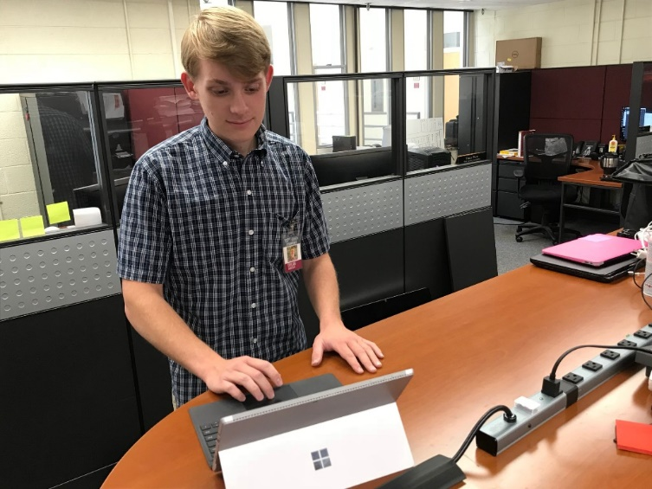
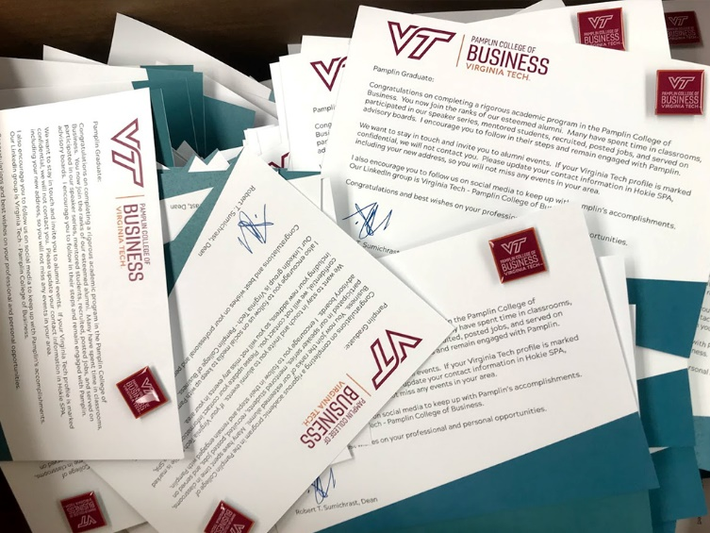
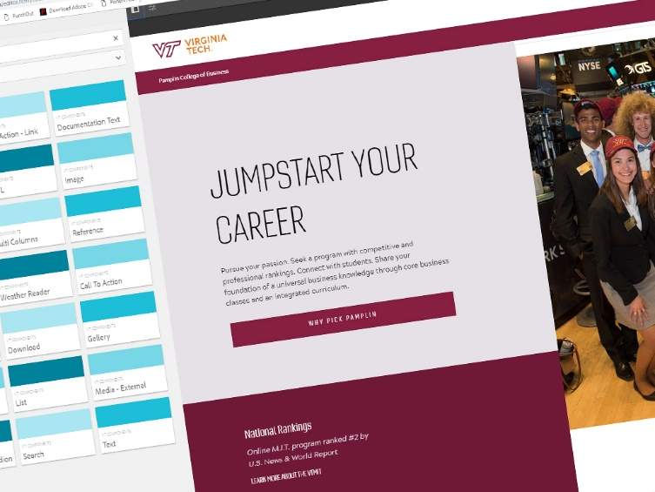
INSTITUTING ServiceNow
HELP DESK
Started using ServiceNow – March 2018
Multiple Vector In
In Person
PRINT SHOP
Call
Online (pamplin.help)
WEB
2,906 tickets since March

Slide 9
DEVELOPING an IT Service Management Strategy
What core services do we support and provide?
What new services should we be supporting?
What services should we NOT be supporting?
Do we have adequate bandwidth to support with the current resources?
When & where should we offer support?
Who should be providing differing levels of support?

Slide 10
LEVERAGING THE DATA
Bandwidth
Number of Tickets
Cost per Ticket
Number of Student Solved Tickets
Distribution between Core Service Areas
Duration of Open Ticket
Active Tickets
Time & Location
Metadata of Ticket
Submission type
Time of day submitted
User submitted or technician submitted
Core Services
Category

Slide 11
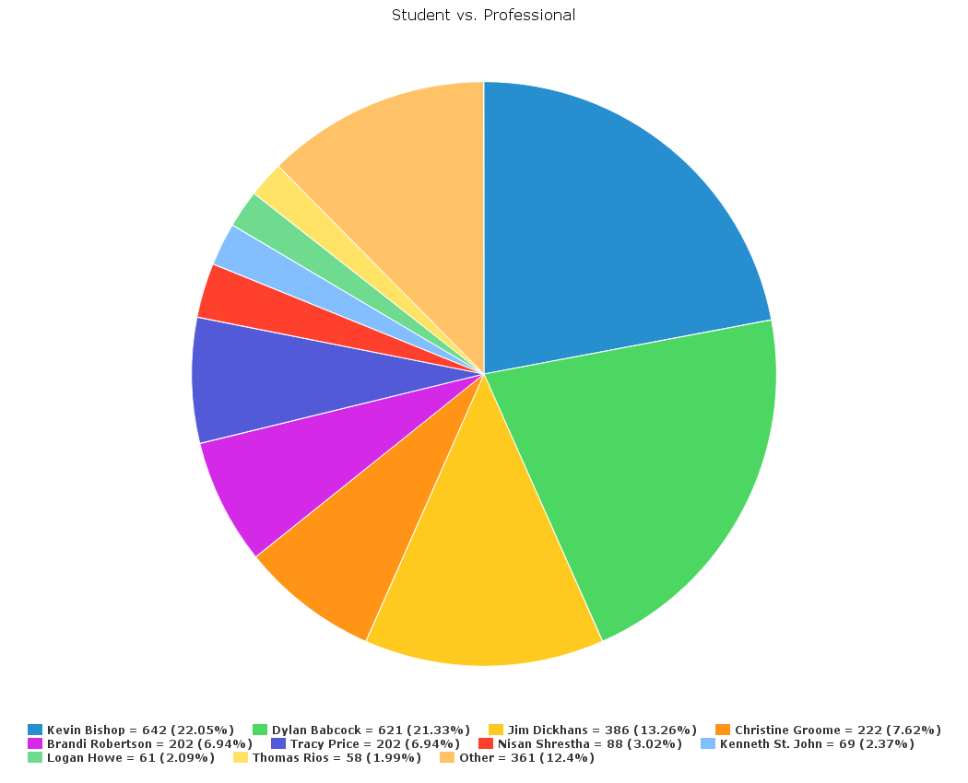
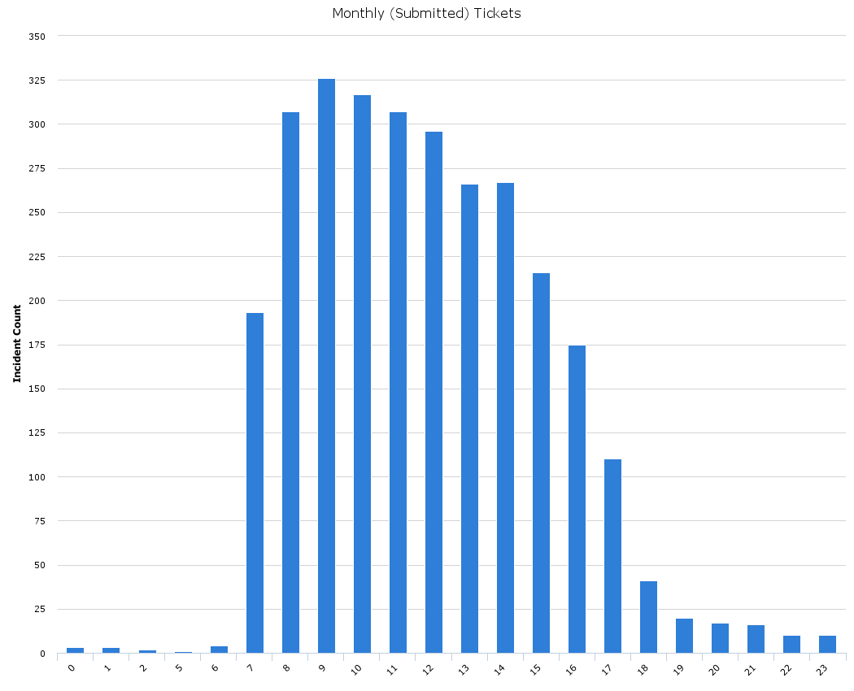
LEVERAGING THE DATA
ANSWERING THE QUESTION: How do we lower our cost per student ticket?
Student Ticket Count
Student Hours

Slide 12
SUCCESS IN PAMPLIN
Communication via ServiceNow
Ticket/Incident Tracking
Routing
Connected with many DoIT Units
See most User Data

Slide 13
NEXT STEPS FOR PAMPLIN
Leverage the Service Catalog
Incidents vs. Requests vs. Request Items
Routine/Planned vs. Impromptu Issue
Automation
Preventative “Incidents”
Workflows
Expand to Other Core Service
System/Application Development

Slide 14
LEVERAGING ServiceNow
ServiceNow license costs are $500 per user per year, which is the cost straight from the contract
Student licenses are currently and into foreseeable future free (as in no added charge)
To join ServiceNow, you will need to complete an MOU and determine the number of licenses needed.
If you are interested in learning more or want to licensing, then please contact Dave Duckett at dcd@vt.edu or 1-2313.

Slide 15
4HELP SERVICE PORTAL ServiceNow

Slide 16
Upcoming ServiceNow Training
ServiceNow 101 Monday, November 5, 2018 2:00 to 3:30 Andrews Information Systems Building 1700 Pratt Drive Room 208 To Register Look for ServiceNow 101 in NLI Course Offerings LIMITED TO 15 PARTICIPANTS | ServiceNow 102 Thursday, November 8, 2018 1:30 to 3:00 Andrews Information Systems Building 1700 Pratt Drive Room 208 To Register Look for ServiceNow 102 in NLI Course Offerings LIMITED TO 15 PARTICIPANTS
Notes:
If you’re interested in ServiceNow training, we have sessions coming on Nov 5 and Nov 8.
Participants will need to bring a laptop.
To Register Look for ServiceNow 101 or 102 in NLI Course Offerings

Slide 17
Questions?
Jim Dickhans, jdickhans@vt.edu
Anne Sheppard, ashepard@vt.edu

Slide 18
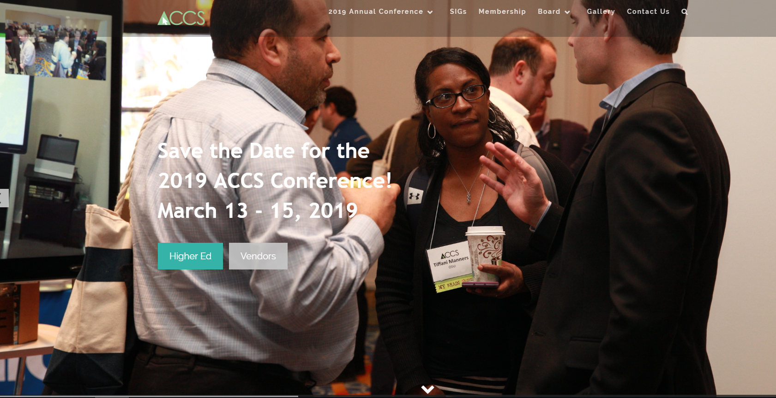
Make Plans Now To Attend ACCS 2019 The Association of Collegiate Conference Services of Virginia For Full Details Visit: www.accsva.org

