Slide 1
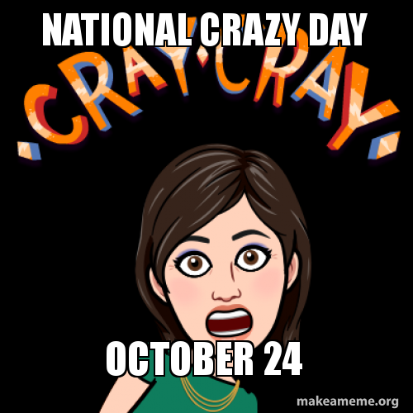
October 24, 2018
Did You Know Today is National Crazy & National Bologna Day

Slide 2
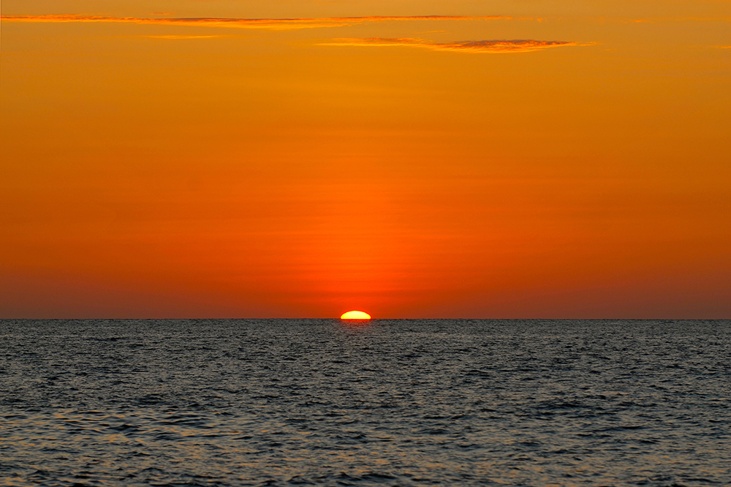
I may be Crazy, but it is No Baloney that Banner 8 is Sunsetting!

Slide 3
Banner 8 is Planned to Go Away on November 5, 2018

Slide 4
There are a handful of Banner 9 forms that are being fixed. We don’t believe any of these to be showstoppers.

Slide 5
The Javascript Engine in Chrome and Firefox seems to work better with Banner 9 than the Internet Explorer Javascript Engine

Slide 6
Clearing the Browser Cache Fixes the Spinning Wheel of Death Issue

Slide 7
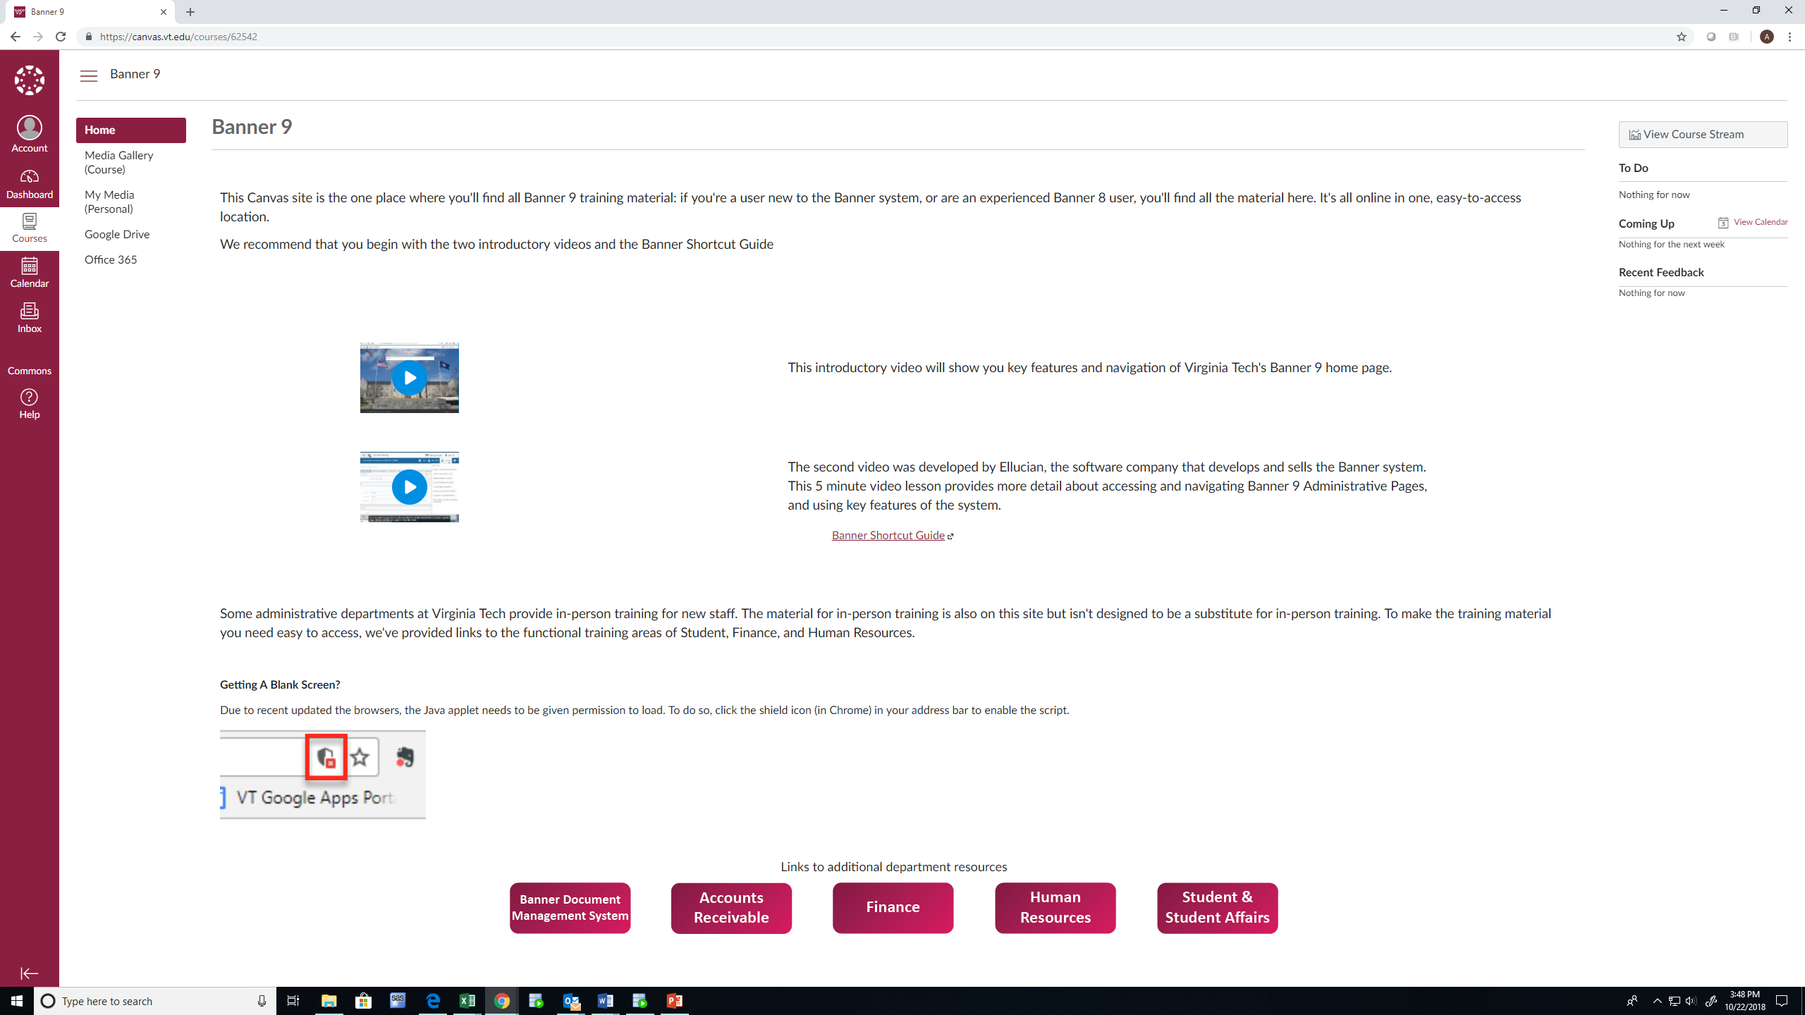
Need Training? The Canvas Class is available from banner.vt.edu

Slide 8
Contact 4Help to report a problem or email Askbanner9@vt.edu to ask a question

Slide 9
Follow Enterprise Systems at #vtenterprise

