Slide 1
One Theme - Ensemble CMS
One is the current VT theme.
Start thinking about adopting it for Ensemble sites
New Ensemble sites should launch into One

Slide 2
One Theme - Outside of Ensemble
Should follow brand guidance
https://code.vt.edu/unirel/brand-header-footer
Eyebrow, Header, Menu, Search, black Footer

Slide 3
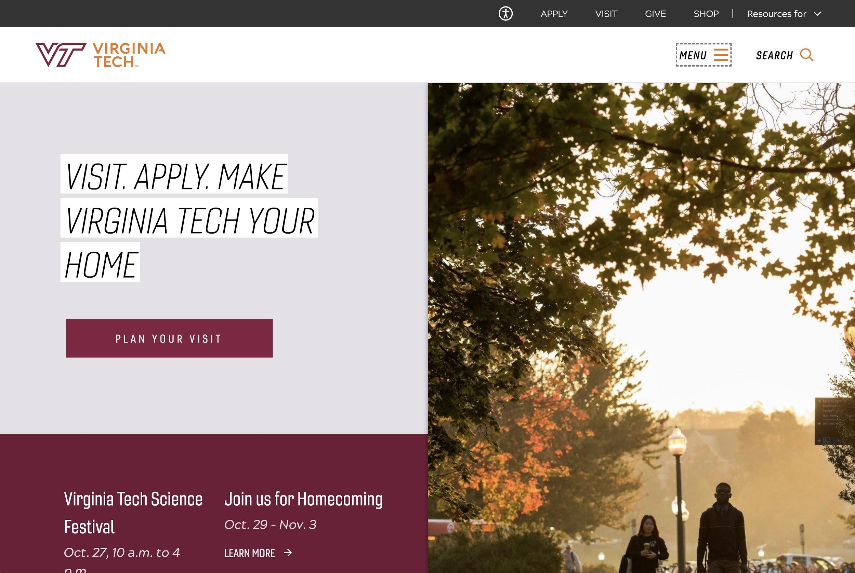
One Theme - Outside of Ensemble
Should follow brand guidance
https://code.vt.edu/unirel/brand-header-footer
Eyebrow, Header, Menu, Search, Black footer

Slide 4
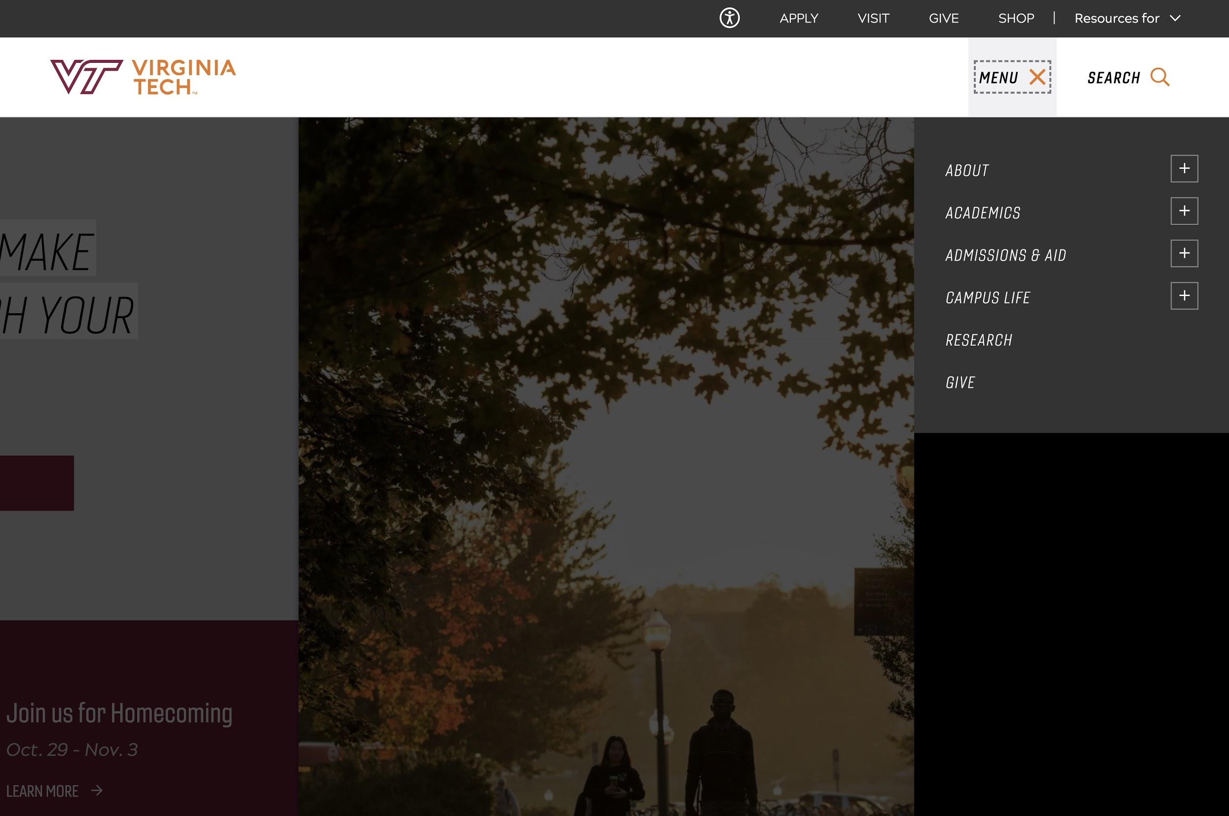
One Theme - Outside of Ensemble
Should follow brand guidance
https://code.vt.edu/unirel/brand-header-footer
Eyebrow, Header, Menu, Search, Black footer

Slide 5
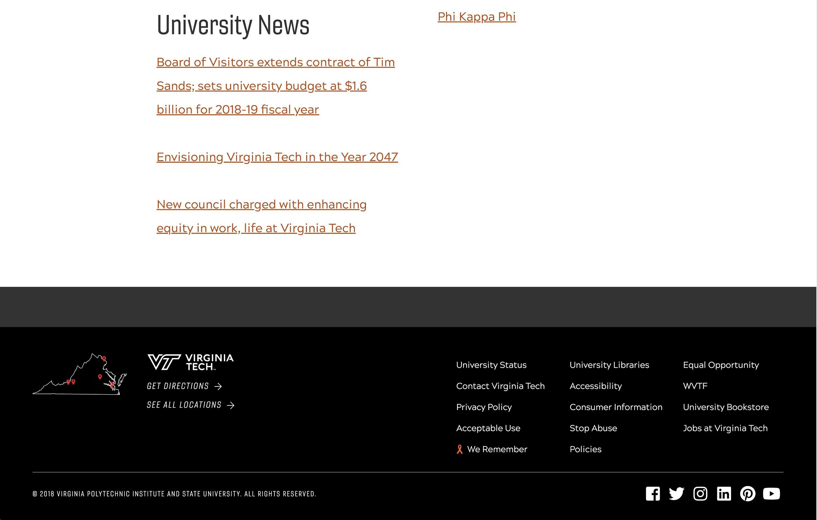
One Theme - Outside of Ensemble
Should follow brand guidance
https://code.vt.edu/unirel/brand-header-footer
Eyebrow, Header, Menu, Search, Black footer

Slide 6
New Hire for University Relations
User Experience focus
Strong design experience
Testing and metrics

Slide 7
Contact Us
Ensemble.cms.vt.edu to file a ticket
Your lead communicator
AskVT@vt.edu for theme feedback

Slide 9
Ensemble CMS - One Theme
One is the current VT theme. Organizations are encouraged to adopt it and new organizations should launch in the One theme.
Existing websites have some time (probably a year) to convert to One's UX, headers, menu, search, and footer.
If Ensemble CMS doesn’t fit your needs, you can find the basic HTML, CSS, and JavaScript used to make the One theme here - https://code.vt.edu/unirel/brand-header-footer
University Relations now has a new UX person on staff
If you have questions, reach out to the Ensemble team or University Relations. Existing websites have some time (probably a year) to convert to One's UX, headers, menu, search, and footer.

