Slide 1
Enterprise Systems Update
April 2018

Slide 2
Agenda – a sampling of what we’ve been up to
Our portfolio
Supporting a transformational project for VT
Banner 9 Administrative Pages
Integration projects
A few other things

Slide 3

Integration-Centric Application Portfolio
Ellucian Banner ERP
New applications not available in Banner
Applications in the Cloud and On Premise
Web Apps
Employees
Students
Faculty
Banner Enhancements & Mods
45+ Vendor Apps
Notes:
Web Apps
Employees
Students
Faculty
Administrative Apps
Finance
Human Resources
Student
Financial Aid
Ellucian Banner ERP
45+Vendor Apps
Payments, Financial Aid, Procurement,
Cashiering, Student Applications,
International Students,
Employee Recruiting, etc.
Our work has changed from a development focus to a focus on application integration. In the past ES did a lot of development for new applications that weren’t in Banner. Now the functional areas are exposed to …
In total our applications portfolio has 170 applications, mods etc in our inventory. Our aspiration is to continue to minimize Banner customizations and our development work whenever possible
New applications not available in Banner
Enhancements & Modifications to Banner

Slide 4
Integration-Centric Application Portfolio
Banner/Ellucian excerpt
Vendor
Applications
Ellucian
Integration Platform ETHOS
BANNER
VT Mods
VT Created
Applications

Slide 5
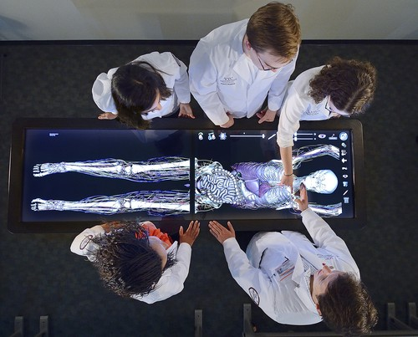

“
Supporting a Virginia Tech transformational project
Courses, Admissions, Academic History, Transcripts in Banner
Go live by July anticipated
A unique partnership between Virginia Tech and a private health care provider (Carilion Clinic) — is a fully accredited, private four-year medical school.
The school is among the first of the new generation of medical schools in the United States.
Notes:
In July, VTC SOM became Virginia Tech’s ninth college, allowing our partnership with Carilion Clinic to “graduate” to the next level.” – Tim Sands
This addition of a medical school is transformational for VT, and we’re supporting this transformation in a basic way.

Slide 6
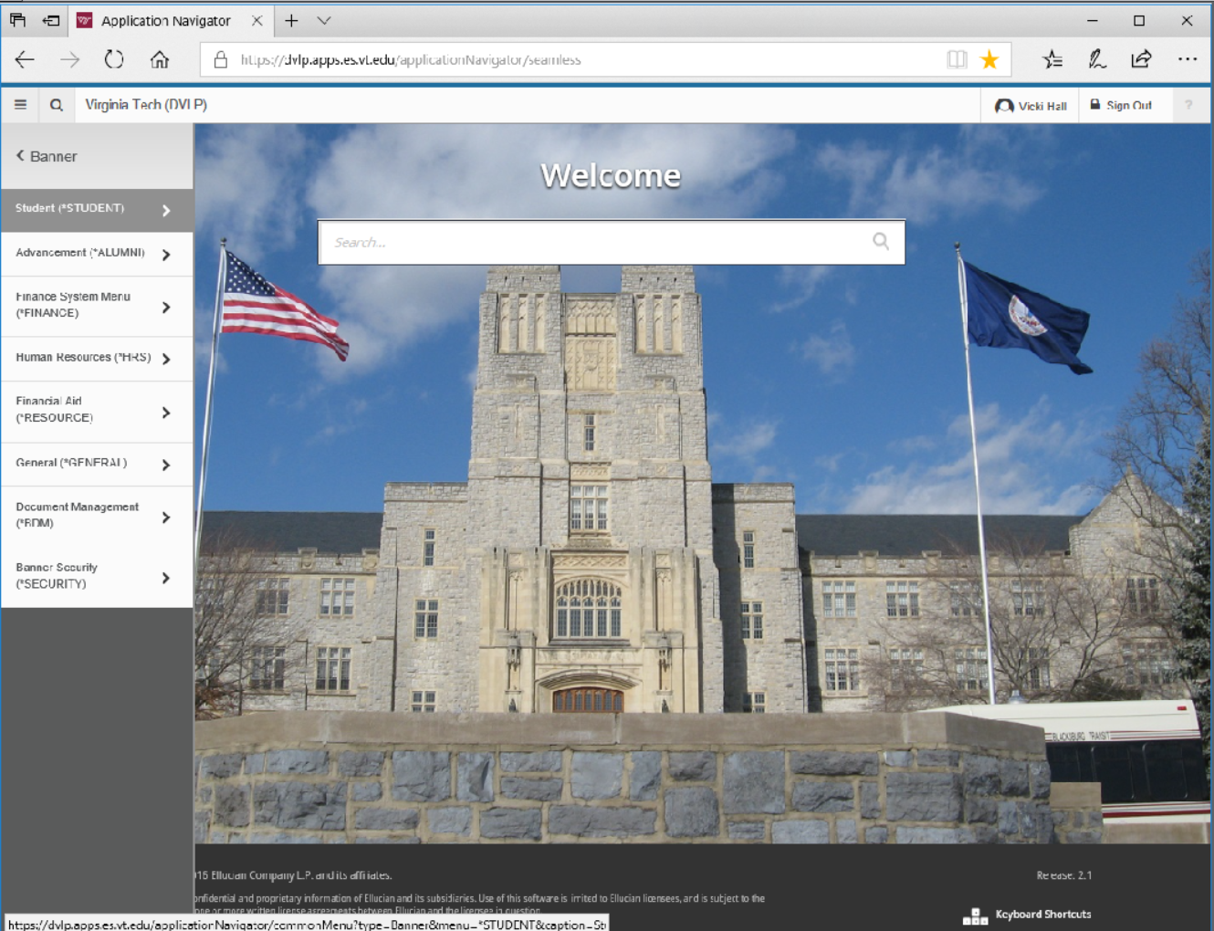
Banner 9 Administrative Pages
Upgraded, responsive UI
Browser independent
Updated technical infrastructure
Database unchanged
Notes:
We began working on the project to convert Banner 8 Internet Native Banner Banner INB to Banner 9 late last spring.
Aspects of Banner 9 Adminstrative Pages include:
Upgraded, responsive UI
Browser independence,
Update technical infrastructure – application navigator
The project doesn’t involve a database upgrade, which makes the rollout easier. The two versions Banner 8 INB and Banner 9 can coexist.

Slide 7

Banner 9 is live

Slide 8
Project aspects
Hybrid Agile development approach
27% of our customized forms were eliminated
Remaining 351 modified forms divided between VT Tiger team and offshore developers
Project launched with training Tiger Team on conversion tool
ES Tiger team – new hires with no Banner knowledge
Together in a room each morning with their leader for 5 months
Standardized development environment
Frequent, regular (bi-weekly) deployments

Slide 9
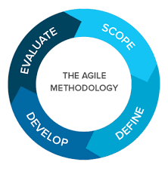
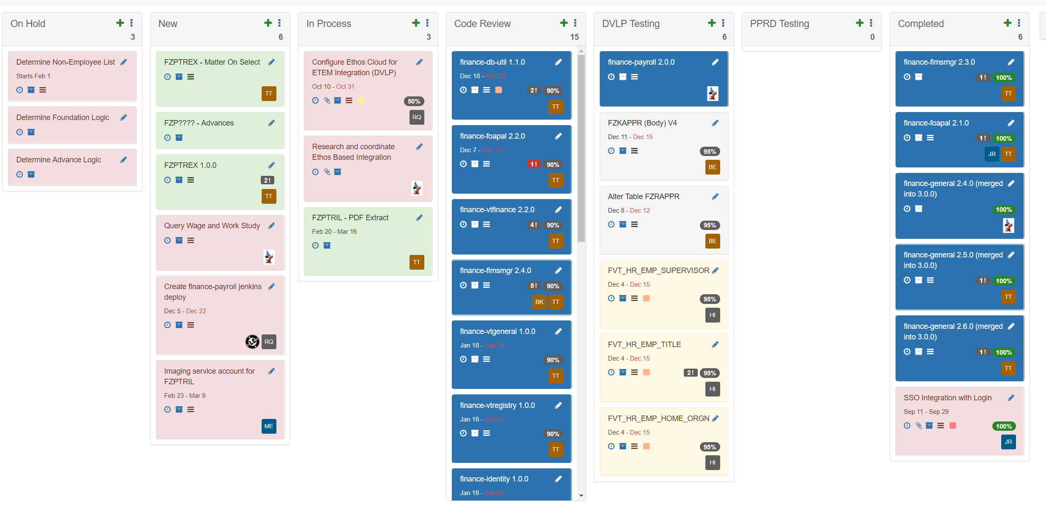
Project Lessons
Prepare for more frequent deployment cycles
Apply process we followed with Banner 8 INB to Banner 8 Self-Service
Build a DevOps culture
Docker
Communicate daily
ScrumMaster and ProductOwner training for ES team members

Slide 10
Some of our Integration Projects
Finance – Controllers Office
University Libraries
Career and Professional Development
Human Resources
Undergraduate Admissions
Platform for standardizing API-based data integration and processes to support emerging data management technologies

Slide 11


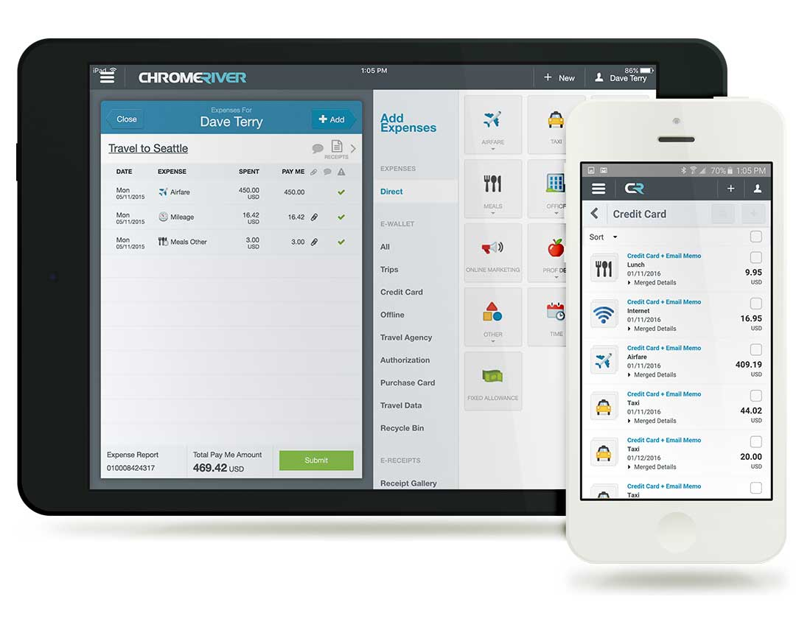
The Virginia Tech Controller's Office provides fiscal services to the university and serves as an interface with external agencies for fiscal matters.
WIP project - Banner travel system replacement
First integration using Ethos platform
Go live this year
Notes:
We’re working with the controller’s office on implementing the Chrome Rive Travel system. This is a replacement for the current Banner Travel system, and should be in place this year.

Slide 12

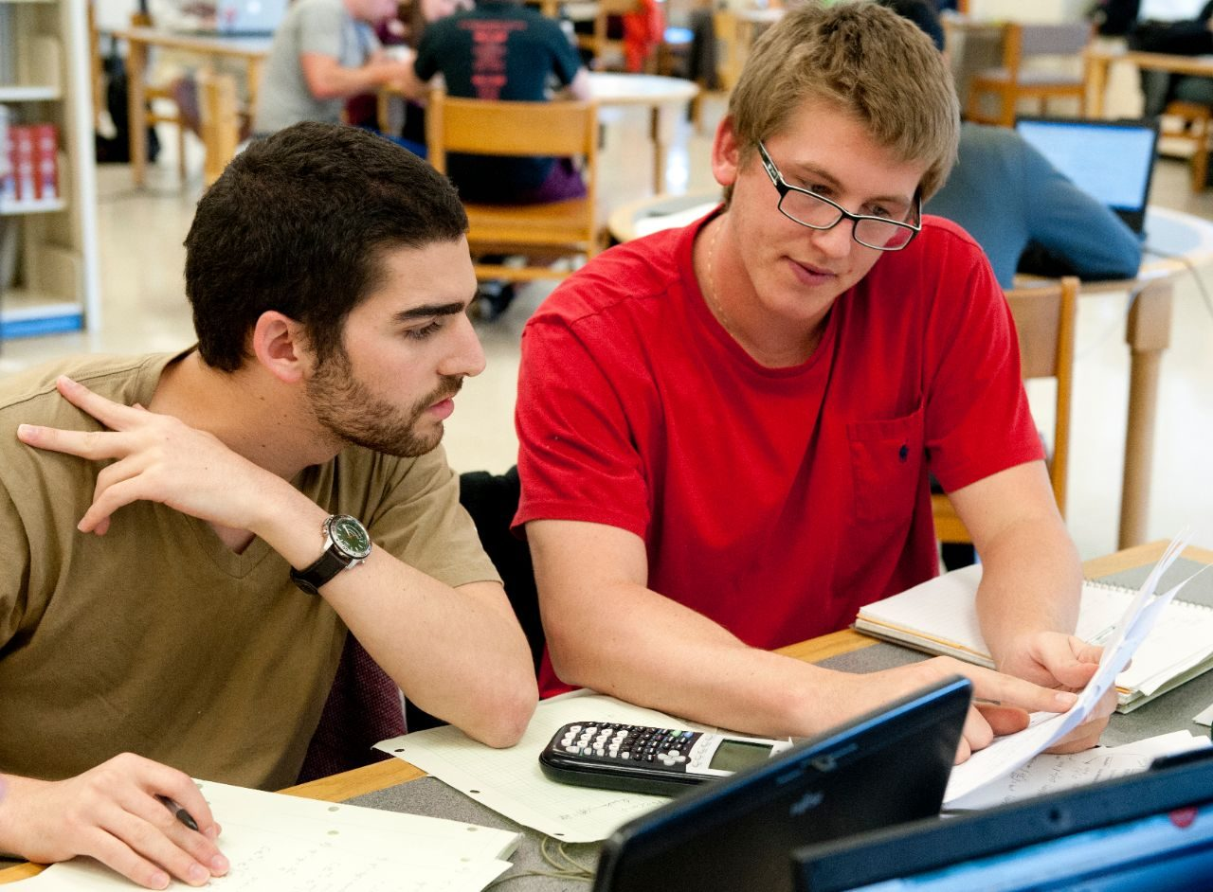

“
WIP project
Open source integrated library system
Integration with Student, HR and Finance data
Go live May 15
We strive to share information and knowledge regardless of geographic, institutional, or financial barriers, through our growing open data and research repositories.
Notes:
Koha is an open source system integrated library system and community. Integrated functions of acquisitions, circulation, cataloging, serials management, reporting label printing, etc. Integrations with Finance, Student/Academic and HR.

Slide 13

An ePortfolio is a digital collection of work that documents and showcases knowledge, skills, and abilities, and their growth over time.
The objective of an eportfolio is to support students and faculty create repositories that promote teaching, learning, and assessment.
Completed late last year
Notes:
For students and faculty
An ePortfolio may include:
Writing samples (research papers, essays, fiction, reflections, journals) Photos/slideshows/videos/audio or other types of media files
Research projects
Links to blogs, web pages, or other online content
Can be accompanied by reflection on how or why the item is included in the ePortfolio
Creating an ePortfolio is a great way to build professional network because it allows you to demonstrate your skills.
It’s also an easy way to store your work in one space that can be accessed and edited, even after you graduate.

Slide 14



Active project
Cloud service for student, career centers and recruiters meet and share opportunities
Plan: deploy during Summer 2018 in between Spring and Fall semesters
Vision
The vision of Career and Professional Development is to empower students to discover and pursue a path to a fulfilling career, so they can make their own unique marks on the world.

Slide 15

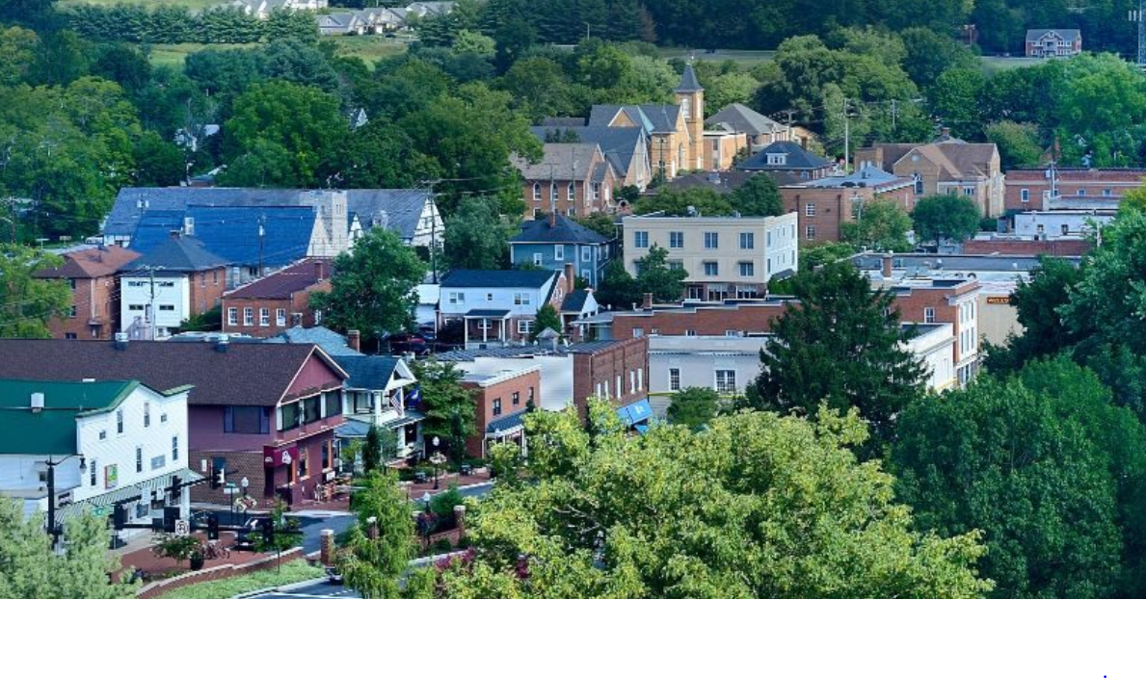
More than 13,000 employees
Project to help streamline applicant tracking process
Replacement for People Admin
Requirements completed
Service providers being evaluated
The department provides services that support the university’s leadership and employees, enabling them to achieve their goals and the mission of Virginia Tech.

Slide 16



Project to improve undergraduate admissions process for prospective students and their families
Requirements completed
Service providers being evaluated

Slide 17

Working with others in IT on a platform for
Standardizing API-based data integration and Extract, Transform and Load (ETL) processes
Support for emerging data management technologies
Talend - open source

Slide 18
A few other things….
Web distribution update
Spring Banner upgrade
Hokiemart upgrade
New Banner Document Manager version
Oracle Database Appliance

Slide 19
Questions?
?
Thank you

