Slide 1
Video for Instruction Overview
Dan Yaffe
Learning Technologies Specialist
TLOS
A Unit of the Division of IT
Notes:
Do Attendance as people walk in. WELCOME THEM.

Slide 2

Zoom contract signed with Internet2
  Ed Site License Bundle for 7,500 – 9,999 Total Size FTE
      7,800 – Pro Licenses for Faculty/Staff
      33,000 – Pro Licenses for Students
      Unlimited Basic (Free) Licenses for VT Affiliates
All WebEx videos are being moved to our new
video content management system for you
WebEx support end date is JUNE 15th, 2018
Notes:
Zoom is our new Video Conferencing System..
Included Features
7,800 – Large Meeting 200
200 – Webinar 500 – Requestable feature
750 – Cloud Room Connectors- This means that it is compatible with existing Polycom rooms that Webex was not compatible with. Your department can make equipment last longer if need be. This could save money in the long run.
[Transition] Zoom includes additional features

Slide 3
Zoom launched on March 19th 2018
2300 users activated their account
SSO and 2FA required
Have held over 800 meetings and 40 Webinars
120701 meeting minutes and 2901 participants in 28 different countries since March 19th, 2018
Notes:
GAE Accounts do not work. Each account needs to be tied to a person that can 2fa. You can assign co hosts and authorized schedulers

Slide 4
Webinars - 200 Campus licenses requestable via service now
Zoom Webinars have been Requested – 38 Held
Zoom Webinar Consults have taken place for self service live streaming events.
Zoom to go bag available in the I/O Studio
Notes:
For up to 500 users 100 interactive and 400 view only. Can livestream to YouTube and Facebook live.
The requested licenses have an expiration date
One button live streaming to Facebook Live and Youtube

Slide 5
Pre-purchased 50 Zoom room Licenses; 47 requested Zoom rooms so far. Connected Classrooms will begin install mid May
Split 50/50 between classroom or conference room use
VFI Room Systems Working Group
Notes:
We have begun working with partners to identify Zoom Room spaces and how they may be configured
Zoom Rooms are a hardware and software solution with an annual license fee of $324.
Requires a resource account in Google or Exchange. We have tested Google Calendars and have outlined the process for Google.
We have setup a VFI Room system working group in a google group for adopters to share information and as a central repository to share best practices so knowledge can be gathers to make the process go faster in the future
Zoom Room installs for Connected Classrooms will take place over the summer and will be ready for Fall.

Slide 6
Premium Audio- The Toll Free number and Call Me Back feature are off by default. VOIP and the Toll number are the preferred way to connect.
Knowledge Base: KB0011646
ServiceNow: Zoom - Webinar Feature Request
Integration into Canvas is being tested

Slide 7
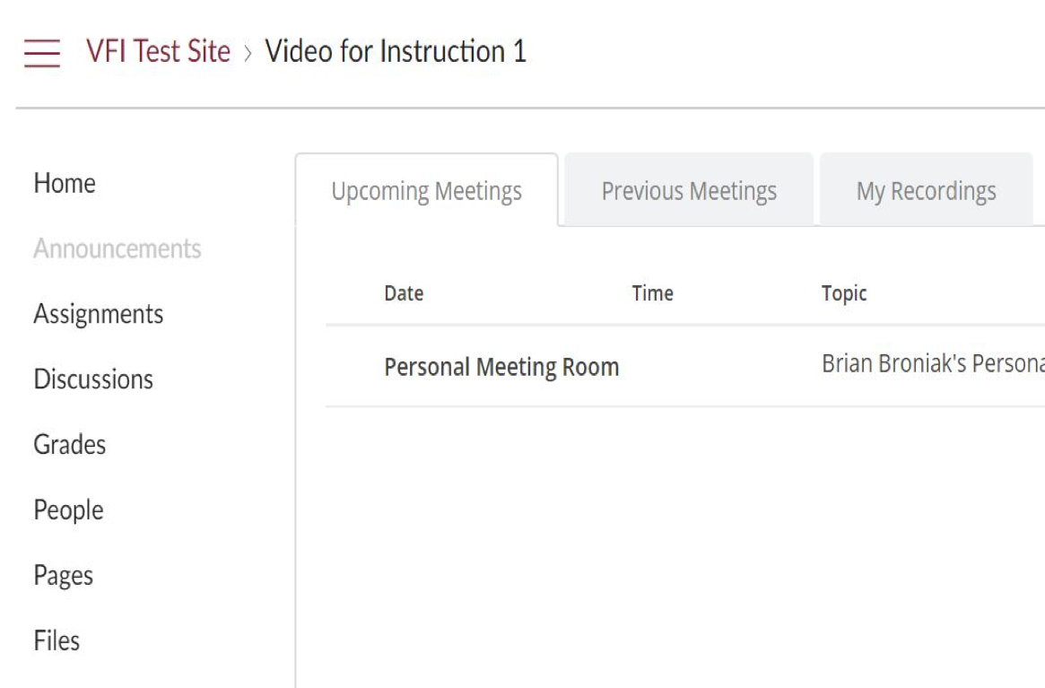
Canvas Integration
Users can leverage Zoom meetings from within a Canvas course.
Zoom integration with Canvas supports the ability to:
join meetings,
schedule meetings,
list upcoming and previous meetings,
and view recordings
Notes:
Canvas Integration
Users can leverage Zoom meetings from within a Canvas course. Zoom integration with Canvas supports the ability to join meetings, schedule meetings, list upcoming and previous meetings, and view recordings within the Canvas account.
Mention: Kaltura Integration and one stop shop for video
Automatically upload your Zoom cloud recordings to Kaltura after your meeting ends. (Participants may ask what is Kaltura)

Slide 8

Notes:
All faculty, staff, and students will have access. Integrated into Canvas. Echo end of support is June 15th 2018

Slide 9
Kaltura licensed for all faculty, staff, and students
Kaltura test instance is up and in the process of being configured
Kaltura integration into Canvas is being tested

Slide 10
Webex Content is being transferred into Kaltura
Echo360 Content will be transferred by the end of June 2018
Kaltura Lecture Capture Boxes are being tested and will replace Echo360 capture devices this summer

Slide 11
Kaltura Media Space is a public facing video repository that can have video groups and channels.
University Relations and Technology enhanced Learning and Online Strategies are working together in configuring and managing Kaltura Media Space
We are currently identifying use cases

Slide 12
Upcoming Important Dates
May 10th No New Echo Recording
May 10th Zoom and Kaltura will be turned on in Canvas
June 15th End of Webex Support
July 1st Echo Videos will be in Kaltura

