Slide 1
Developer Community
How code.vt.edu connects us
April 9, 2018 @ Spring DCSS
Marvin Addison, Middleware / Mike Irwin, Admin & Planning

Slide 3
VT Code Hosting AKA code.vt.edu
Typical bullet points for GitLab:
Version control
Documentation (wikis/sites via GitLab Pages)
Issue tracking
Powerful code review capabilities
Continuous integration/continuous deployment (CI/CD)
Notes:
This is just a warm up slide to get the audience engaged in the broad topic: leveraging GitLab capabilities for maximum effect. Our slant is that getting the most out of it requires a community and produces a bigger, better community.

Slide 4
No Empty Promises, No Silver Bullets
GitLab itself is none of these:
Revolutionary
Transformative
Game-changing
The solution to all your problems
You ought to be skeptical about any technology that makes promises of this kind.
Notes:
This is just to reassure skeptics that we’re not claiming GitLab is some magic solution.

Slide 5
Sunlight: Good for Code Too
When code has enterprise visibility, a number of new benefits are possible:
University-scale collaboration (ad-hoc)
University-scale code reuse
University-scale code review
University-scale security analysis and defect detection
Mitigate risks (business continuity/code quality/security)
Notes:
Paint a vision of what we could accomplish with buy-in at enterprise scope. Also, speak to risks: single greatest risk to IT service delivery is arguably lone developers working in isolation.

Slide 6
Transformative with Your Help
Enterprise-scale code visibility isn’t something we can do by fiat. We need your help:
Internal project visibility (all logged-in users can see)
Willingness to review code outside your team/org
Willingness to contribute code outside your team/org
Curiosity
Sense of community
Notes:
Enroll the community in the vision.

Slide 7
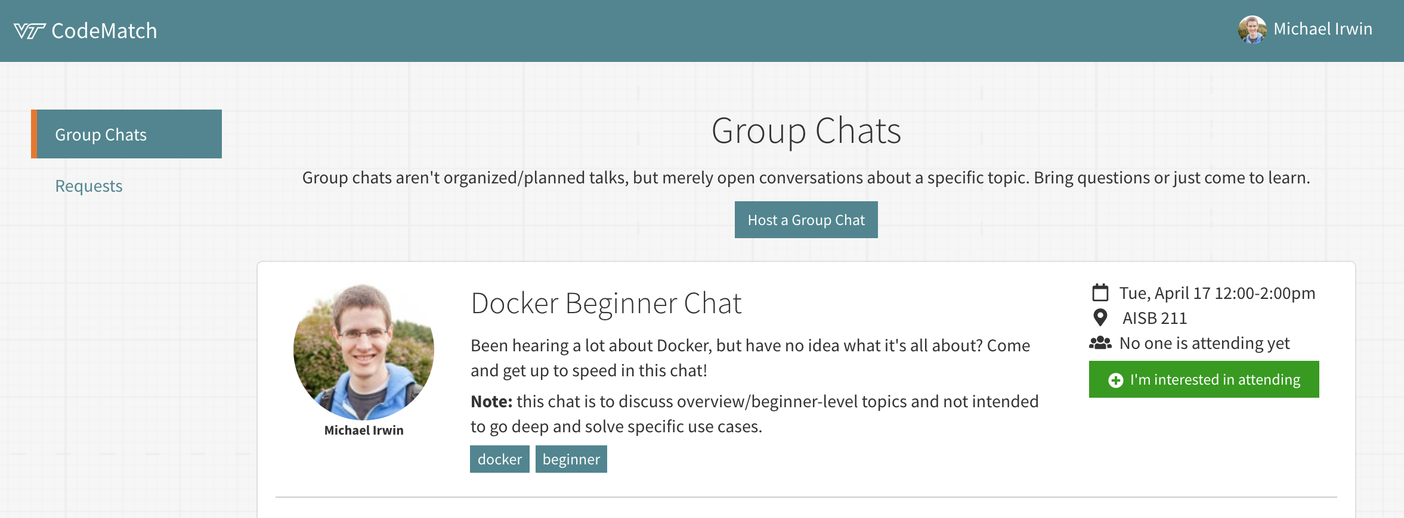
CodeMatch
New app being developed to help facilitate collaboration
Have an expertise? Share it!
Need some help? Request it!
DevCom driven - anyone can contribute!

Slide 8
CodeMatch Roadmap
Be notified of updates/upcoming events via Slack
No more need to check-in on the website
Follow just a specific tag
Integrate with bug tracking systems
Add a label requesting help and adds it to CodeMatch automatically
Auto-suggest people who can help

Slide 9
Open All the Things
For Code Match to work, repositories MUST be as open and accessible as possible. Process:
Audit codebase for adherence to best practices
Choose internal scope for project accessibility level
Use access controls to toggle GitLab feature accessibility

Slide 10
Call to Action
Join the DevCom community!
Join #devcom channel in VT Slack
Join the devcom-g Google Group
We will add you to the devcom GitLab group
Bonus points for folks willing to review code
Attend first event with FREE LUNCH at 12:15 on April 20 in CRC - “Testing in a Containerized World”
Notes:
If we recruit at a handful of new folks to DevCom, it will be worth our time.

