Slide 1
Web Application Security
A Concrete Discussion
with Brad
brad@vt.edu

Slide 2
Common Web App Security Issues
XSS
SQLi
Code Injection
Command Injection
File Uploads
Data Extraction

Slide 3
Some Examples Follow
The people are real
The vulnerabilities are real
The findings are final

Slide 4
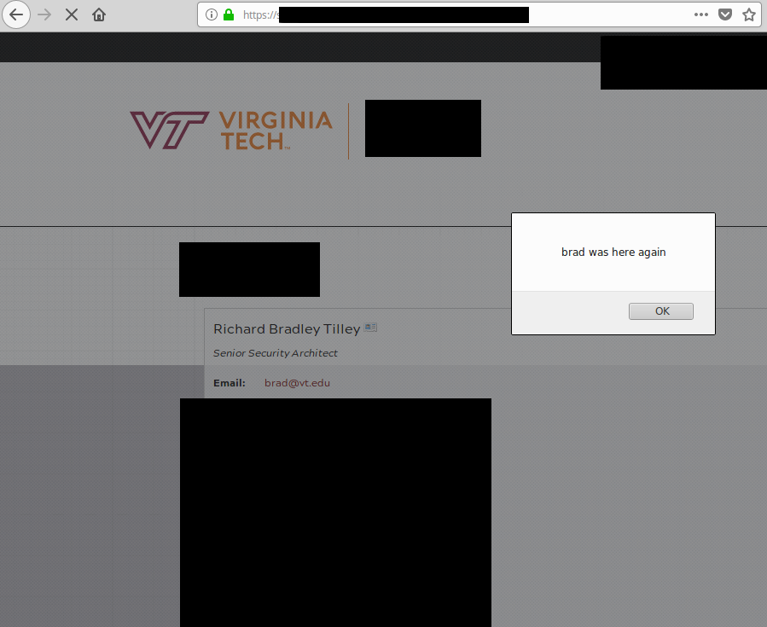
Brad Was Here... Again

Slide 5
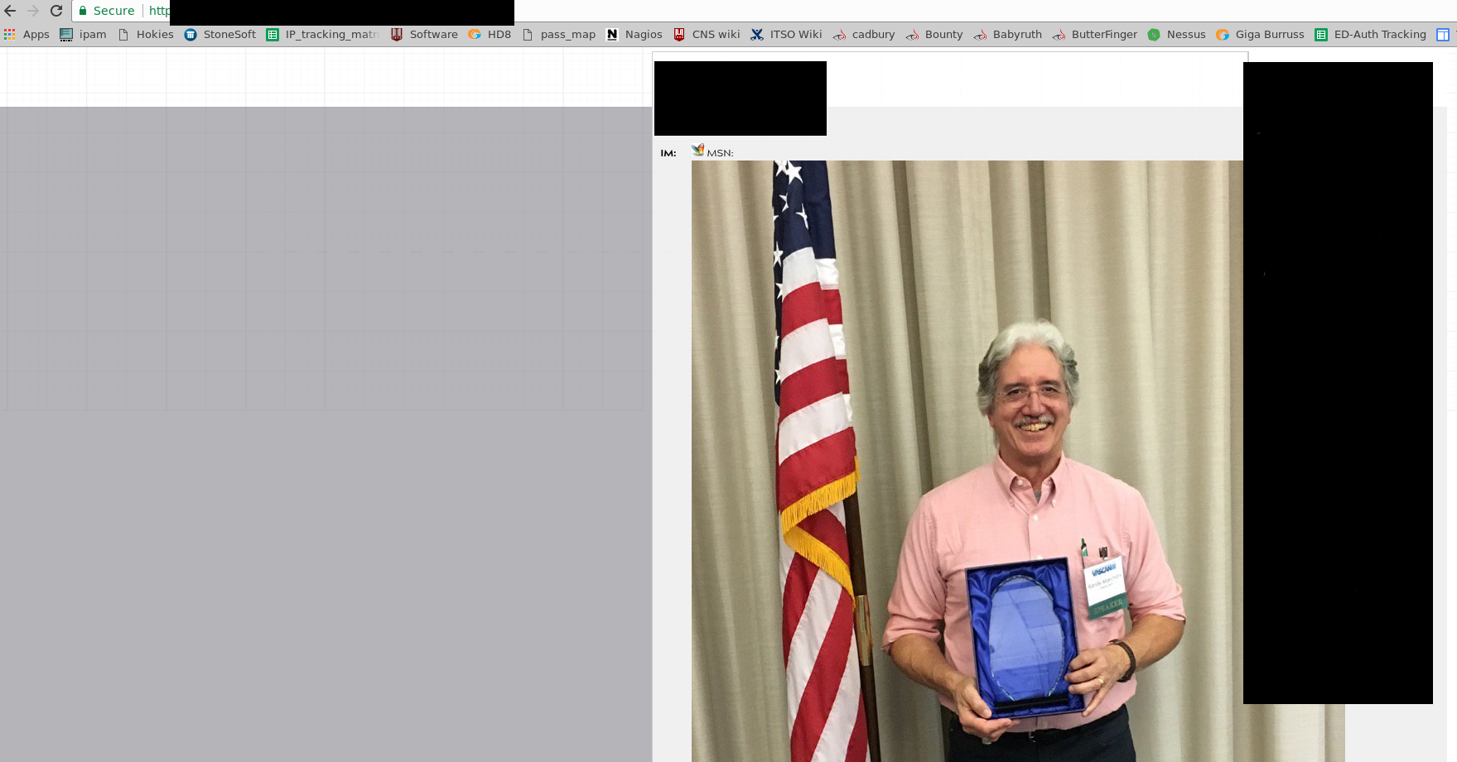
The Randy Award

Slide 6
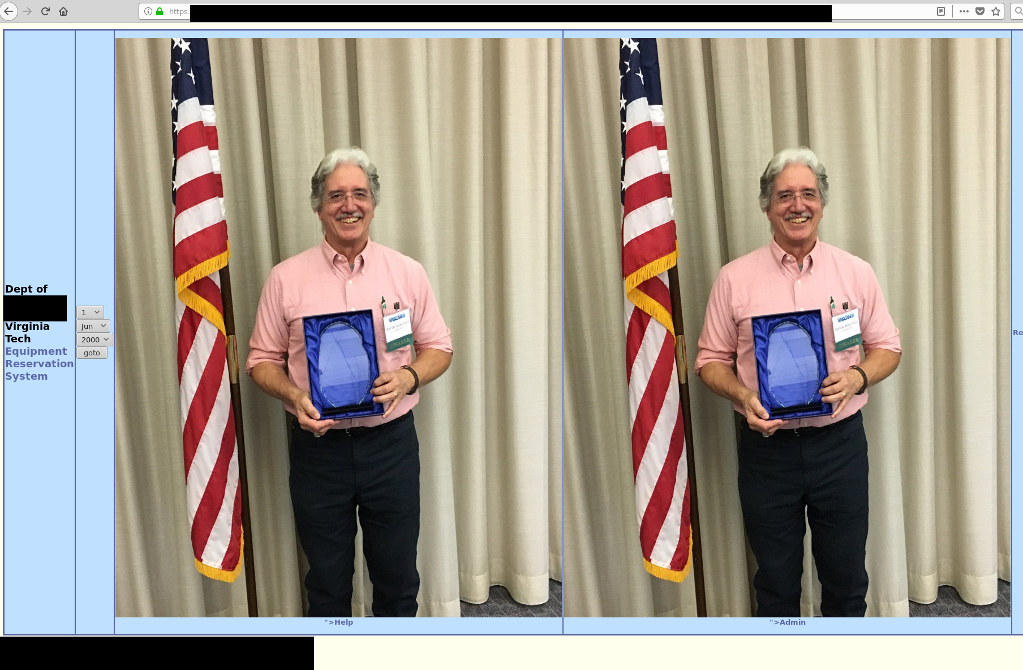
Randy Squared

Slide 7
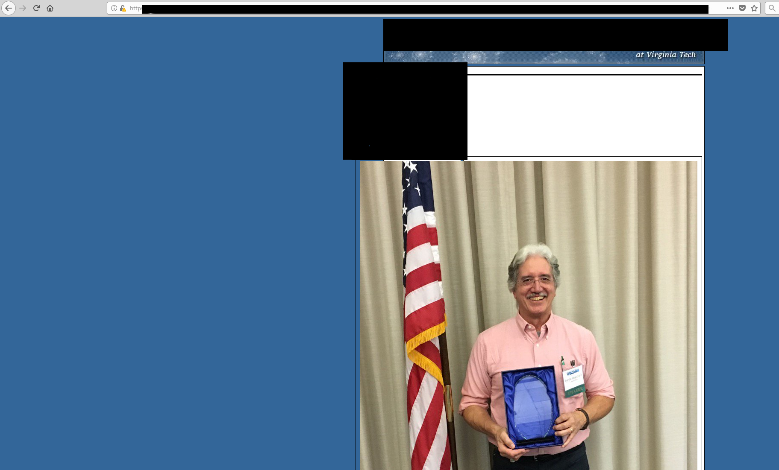
Randy Randy Randy

Slide 8
Manual Process
Expensive
Slow
Knowledge
Time
Motivation

Slide 9
Dorkbot Automation
All notifications will come from
  security@utexas.edu
All checks will come from
  autoscan.infosec.utexas.edu (146.6.15.11)
You might see some manual verification from
  146.6.193.0/24

Slide 10
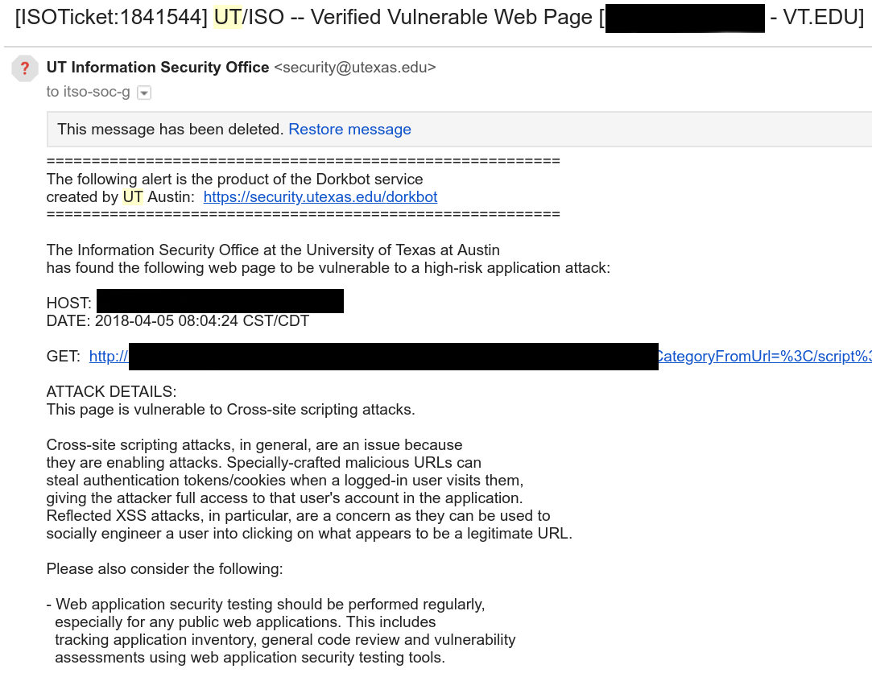
Dorkbot Report

Slide 11
Closing Remarks
University Policy 7010
  ‘Maintain the operating system and application software with appropriate updates’
  Appropriate updates means patches and updates that correct vulnerable code.
Standard for Securing Web Technology Resources
  https://it.vt.edu/resources/policies/index.html
Input validation is to developers what weak passwords are to users.

