Slide 1
Welcome Departmental Computing Support Symposium
Scott Midkiff
Vice President for Information Technology and Chief Information Officer
midkiff@vt.edu
March 1, 2019

Slide 2
Division of IT Staffing Updates
Joyce Landreth is serving as interim Executive Director of IT Experience & Engagement
John Krallman is serving as interim Chief of Staff
Ad is posted for Director of IT Business and Finance position

Slide 3
IT Strategic Plan, 2018-2024
Framework
DRAFT January 2019
Mission Vision Goals
VIRGINIA TECH
IT Strategic Plan
Innovation in Teaching and Learning
Advancing Research and Discovery
Leveraging Technology for Outreach
Enhancing Organizational Excellence
Differentiating the Virginia Tech Experience
PILLARS
Supporting the vision, mission and goals of the University
FOUNDATIONS
Positioning IT for the future
Technology: Investing in Capable, Resilient, and Secure Infrastructure
Processes: Investing in Operational Effectiveness
People: Investing in and Enabling our Workforce
BEDROCK
Our core values
Trust
Inclusion
Care
Service
Striving for Excellence

Slide 4
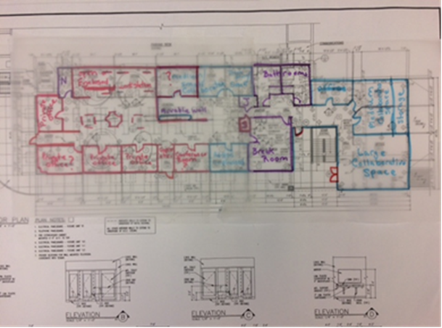
Collaboration Studio @ UMall
Second Floor University Mall (old Rackspace offices)
Co-located with ITEE and a team of IT experts in architecture, cloud and on-demand computing, data design, extraction and analysis
Collaborative space for co-locating teams of cross-functional experts utilizing the space as their primary work site for varying durations throughout the project lifecycle
Co-location of teams can foster shared sense of ownership, speed to decision, cohesiveness, transparency, cooperation between University units resulting in quality project outcomes
More easily define and implement best practices and standard work to better support project life-cycle processes, enable collaborative project planning, and improve productivity and communication
Soft rollout over next several months while continuously improving support systems and developing best practices and metrics

