Slide 1
SENSITIVE DATA STANDARDS

Slide 2
AGENDA
VT Risk Classification Standard – What is high risk data?
Standard for High Risk Digital Data Protection
Minimum Security Standard

Slide 3
AGENDA
GIVE AWAY CANDY!

Slide 4
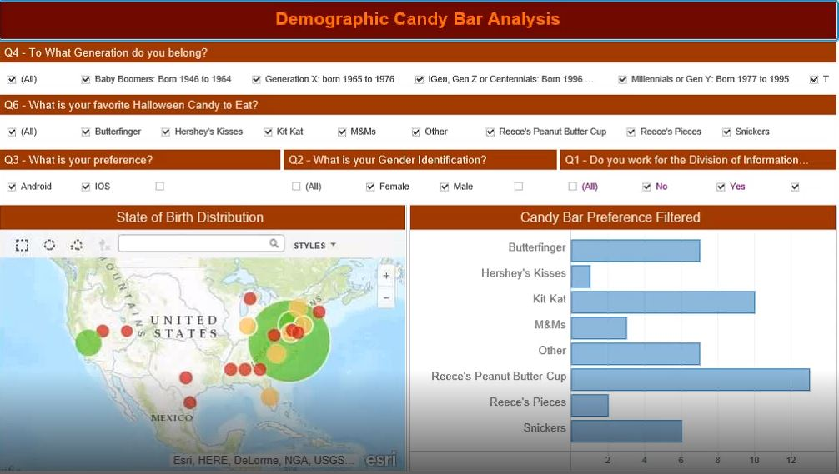
DIVIDER SLIDE #1

Slide 5
Need a volunteer!

Slide 6
What is high risk data?
Protection of the data is required by law/regulation, and
Virginia Tech is required to self-report to the government and/or provide notice to the individual if the data is inappropriately accessed; or
The loss of confidentiality, integrity, or availability of the data or system could have a significant adverse impact on our mission, safety, finances, or reputation.
Virginia Tech
Data Classifications

Slide 7
What high risk data elements are covered in this standard?
Social Security Numbers
Driver’s License/State ID Numbers
Credit/Debit Account Numbers,
Financial Account Numbers,
Passport Numbers
Student data (nondirectory or items marked confidential)
Export Controlled Research Data
Standard for High Risk Digital Data Protection

Slide 8
What element is not covered in this standard but should be?
Standard for High Risk Digital Data Protection
Protected Health Information

Slide 9
02 | SECTION TITLE
Data Element/Type
University Policies and Standards
Laws and Regulations
VT Required Protections
Standard for High Risk Digital Data Protection

Slide 10
Show Standard for High Risk Digital Data Protection

Slide 11
Additional requirements for clients, servers, and applications based on risk of data it stores
Minimum Security Standards

Slide 12
WHERE ARE THESE STANDARDS LOCATED?
it.vt.edu | Resources | Policies and Standards

Slide 13
QUESTIONS?

