Slide 1
Azure Information Protection
DCSS Spring 2019

Slide 2
Launch Details
Azure Information Protection (AIP) will be released to the university on March 15, 2019.
In this presentation, we are going to cover
What does AIP provide your users
What AIP labels will be available at launch
How to use these labels with the Outlook Web Access app
How to use these labels with the Office Desktop Applications
How to apply these labels directly to files or folders
What additional features will be generally available to users with the Microsoft Bundle changes coming in Fall 2019
Notes:
Presentation time limit is 10 minutes.

Slide 3
What does AIP provide your users
AIP is a data-protection solution that helps an organization to classify and protect its documents and emails by applying labels*
AIP Provides
Help with compliancy
Enhanced security
Greater end-to-end control over data
Important: AIP works at the application level. Your data is never stored or uploaded to Azure unless you explicitly store it in Azure
*https://docs.microsoft.com/en-us/azure/information-protection/what-is-information-protection

Slide 4
Labels Available at Launch
PII – Data containing personally identifiable information. Emails and documents marked as PII will be encrypted and recipients of PII labeled emails will be prevented from forwarding
FERPA – Data containing information on student academic records. Emails and documents marked as FERPA will be encrypted and recipients of FERPA labeled emails will be prevented from forwarding
Additionally, Outlook and OWA provide separate options for the following
Encrypt-Only
Do Not Forward

Slide 5
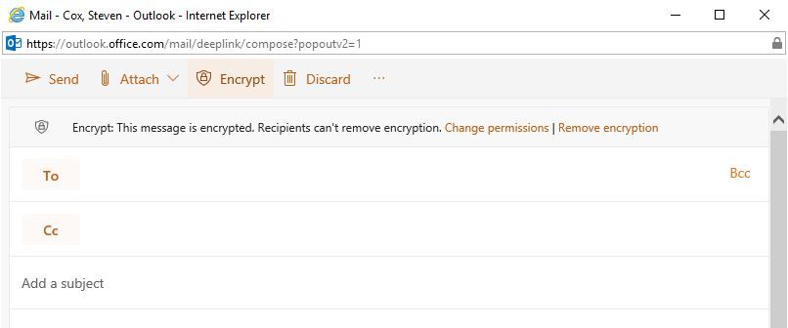
How to access the labels in Outlook Web App
In the new 2019 OWA, the AIP labels are located under the “Encrypt” menu option
Protected emails can be sent to users inside or outside Virginia Tech
Recipients must verify their identities
When you protect an email, the attachments are also labeled and protected (only works currently with Office documents)

Slide 6
Office Desktop Applications require the AIP Client
AIP functionality provided by the AIP Client
Windows OS requires the AIP Client to be installed separately from Office products
Mac OS already have the AIP client installed with Office products
AIP Client link - https://tinyurl.com/zesqfzx

Slide 7
How to access the labels in the Office Desktop Applications
Once the AIP client is installed, the labels appear within each application (Word, Excel, PowerPoint, etc.) at the top of screen
Labeled items require authentication to access
Users who can’t authenticate against originating tenant would see a permissions pop-up that would redirect them to create a guest account within that tenant

Slide 8
Applying these Labels Directly to Files or Folders
File – Direct classification with label outside of an Office application
Folder - Assigns classification level to all files within that folder

Slide 9
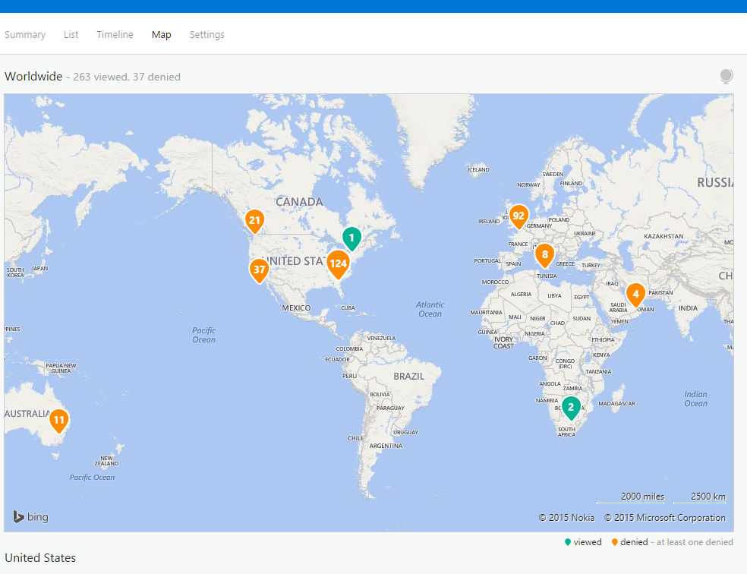
Additional Feature with the Microsoft Bundle changes coming in Fall 2019
Reporting and Monitoring
Users can track/revoke their own documents
Document Tracking/Revocation requires Azure Information Protection P1

