Slide 1
Spear Phishing Awareness
DCSS Spring 2019
Marc DeBonis
V1.0

Slide 2
Obligatory Wikipedia
Phishing is the fraudulent attempt to obtain sensitive information such as usernames, passwords and credit card details by disguising as a trustworthy entity in an electronic communication. Typically carried out by email spoofing or instant messaging, it often directs users to enter personal information at a fake website, the look and feel of which are identical to the legitimate site.
Phishing is an example of social engineering techniques being used to deceive users. Users are often lured by communications purporting to be from trusted parties such as social web sites, auction sites, banks, online payment processors or IT administrators.
Attempts to deal with phishing incidents include legislation, user training, public awareness, and technical security measures — because phishing attacks also often exploit weaknesses in current web security.
Phishing attempts directed at specific individuals or companies have been termed spear phishing. In contrast to bulk phishing, spear phishing attackers often gather and use personal information about their target to increase their probability of success.
The term whaling has been coined for spear phishing attacks directed specifically at senior executives and other high-profile targets. In these cases, the content will be crafted to target an upper manager and the person's role in the company. The content of a whaling attack email may be an executive issue such as a subpoena or customer complaint.
Notes:
Presentation time limit is 10 minutes.

Slide 3
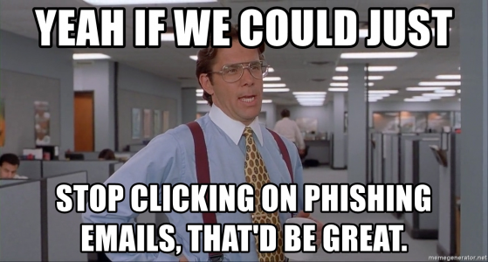
Public awareness/ User Training
Public Awareness
Tech support posting 2/8
Microsoft Users Group 2/14
Phishing Mitigation Poster plans
User Training
Spot the phish training (Google specific-ish)
https://phishingquiz.withgoogle.com/
ITSO sponsored "Securing the Human"
Securing the Human Signup/Seat Request
http://tinyurl.com/y4sel9nu
Updated KB article
KB0011109 "How to protect yourself from phishing attacks"
Notes:
Presentation time limit is 10 minutes.

Slide 4
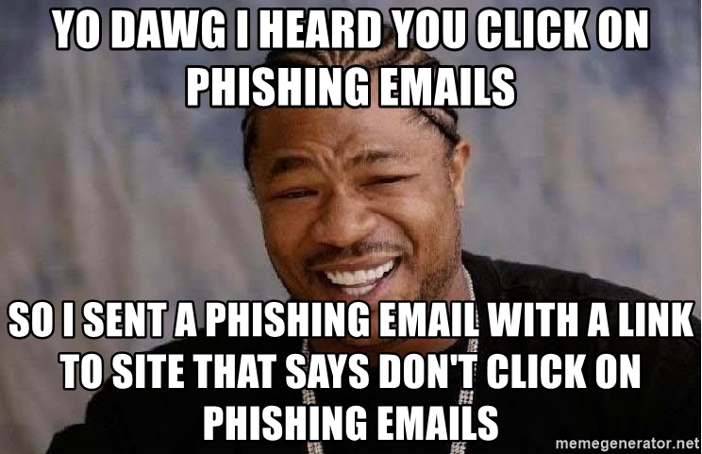
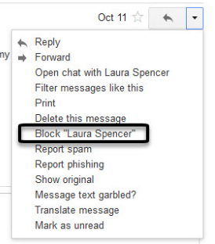
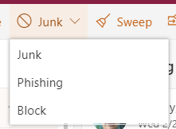
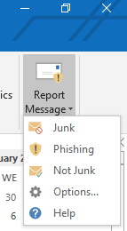
Technical security measures (1 of 3)
Report Message Add-In
The Report Message add-in for Outlook and Outlook on the web enables people to easily report misclassified email, whether safe or malicious, to Microsoft and our email administrators. Microsoft uses these submissions to improve the effectiveness of email protection technologies.
This is already enabled in OWA!
You can enable individually in Outlook 2016!
We will be enabling it for all customers in the VT O365 tenant (Q1 2019)
OWA
Gmail
Outlook 2016
Notes:
Presentation time limit is 10 minutes.

Slide 5
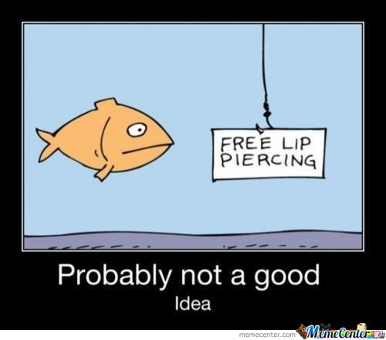
Technical security measures (2 of 3)
Microsoft Advanced Threat Protection (ATP)
Microsoft provides a service to help protect organizations from malicious attacks.
scans email attachments for malware (remote detonation)
scans URLs in emails and Office docs (URL re-write)
checks email messages for spoofing (domain)
detects when someone attempts to impersonate your users and your organization’s custom domains (VIP targeting)
Events and Planned Action Items
Critical Needs Request (CNR) for university wide ATP (faculty, staff, and students)
Microsoft Campus Update on 3/20 – ATP Demo
Notes:
Presentation time limit is 10 minutes.

Slide 6
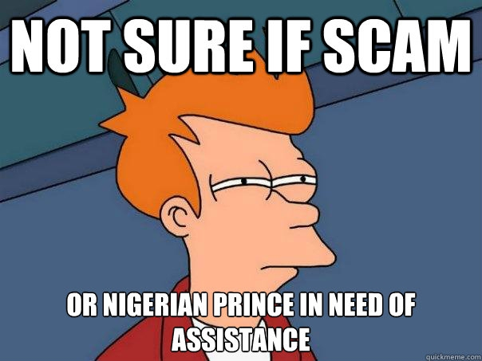
Technical security measures (3 of 3)
Google Enhanced Spam and Malware Protection
Already enabled
Attachment scanning
Links and External Image scanning
Enhanced Pre-Delivery Message scanning
Spoofing and authentication scanning
Planning to enable
Protect against email address not in directory
This require we re-enable general Google directory visibility. Current HB1 legislation seems to be complicating this for students.
Protect against message pretending to be from your domain
We have many 3rd party senders of email as @vt.edu that are not in our official SPF\DKIM records. We need to get them onboard and in a sub-domain or else they will be flagged.
Caveat: Most of these warnings are web UI based and require that you use the Gmail web interface!
Notes:
Presentation time limit is 10 minutes.

Slide 7
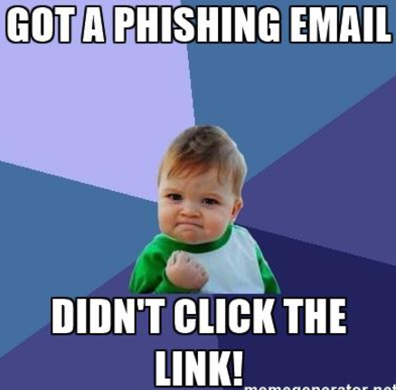
Q&A (if time allows)
Questions, concerns, comments, criticisms, kudos?
Notes:
Presentation time limit is 10 minutes.

Slide 8
Spear Phishing Awareness
DCSS Spring 2019
Marc DeBonis
V1.0

