Slide 1
Open Announcements
DCSS – Spring 2019

Slide 2
Association of Collegiate Computing Services (ACCS) Annual Conference
Just 12 days away, but there is still time to register!
Many exciting networking and learning opportunities for IT professionals in Higher Education
Registration officially closes on March 6 at 8:00 PM -- no onsite or late registrations will be accepted
For more information, visit http://www.accsva.org/
March 13-15
Portsmouth, Virginia
Anne Sheppard

Slide 3
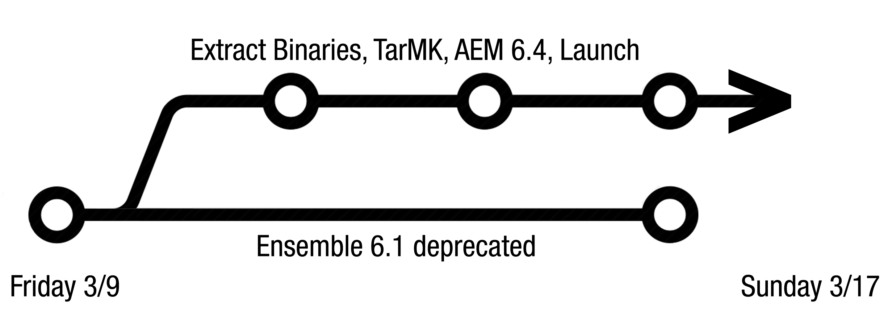
Ensemble CMS Version 6.4 Upgrade
Author Improvements include:
Faster navigation (Content tree)
View as published, better previews (View as published)
Recursive publishing
Architecture improvements (larger binaries)
Training is available at https://ensemble.cms.vt.edu/upgrade
Version 6.4 is now in preproduction: https://ensemble.cms.vt.edu/pprd (uses production VT Username, passphrase, and ED groups)
S.B. Chandler

Slide 4
Distributed Antenna System (DAS)
AT&T has joined the Distributed Antenna System
Official launch was January 30, 2019
Fully executed agreement with T-Mobile to join - construction start TBD
Initial carrier was Verizon Wireless “on the air” in September of 2013
DAS designed for multiple cellular providers
Stadium bowl, all interior and exterior levels, and parking lots
Stadium system used for expansion
Coverage and capacity extended to six Residence Halls
Richard Hach

Slide 5
Volunteer opportunity: KidsTech University Coding Booth
Afternoon of Saturday, March 30
Our booth will involve kids in a quick coding activity where they will program their device to follow their instructions
We need volunteers!
4-6 technical helpers for the kids (folks who know a bit about Arduinos and C++)
2-4 non-technical helpers to work with parents and keep the traffic flow going
A volunteer orientation will be provided
Contact me or Thomas Weeks for more information, or to sign up!
March 30
Blacksburg, Virginia
Thomas Weeks
Angela Correa

Slide 6
Upcoming Microsoft Events
Microsoft Enrollment for Education
Solutions Agreement
When: March 4, 2019 10am to Noon
Where: Skelton Conference Center
Hosted By: ITPALS
Agenda: Microsoft Bundles and Licensing Changes
Microsoft Campus Update
When: March 20, 2019 2pm to 5pm
Where: Skelton Conference Center
Hosted By: CCS and ITPALS
Agenda:
Microsoft Demo of Advanced Threat Protection (ATP) and Phish Hunter
Microsoft Campus Update (latest features and news)
Q&A with Microsoft Reps
Registration Form: https://tinyurl.com/y5tvjgxt
March 4
and March 20
Blacksburg, Virginia
Chris Shively

Slide 7
UEM Proposed Costs Survey
Survey will help gauge responses to estimated costs for UEM services
Intended for all Distributed / Departmental IT personnel.
https://tinyurl.com/y4yhwm8d
David Duckett

Slide 8
Your announcements here!
Don't
Everyone
Talk
At
Once!

